Slide 1
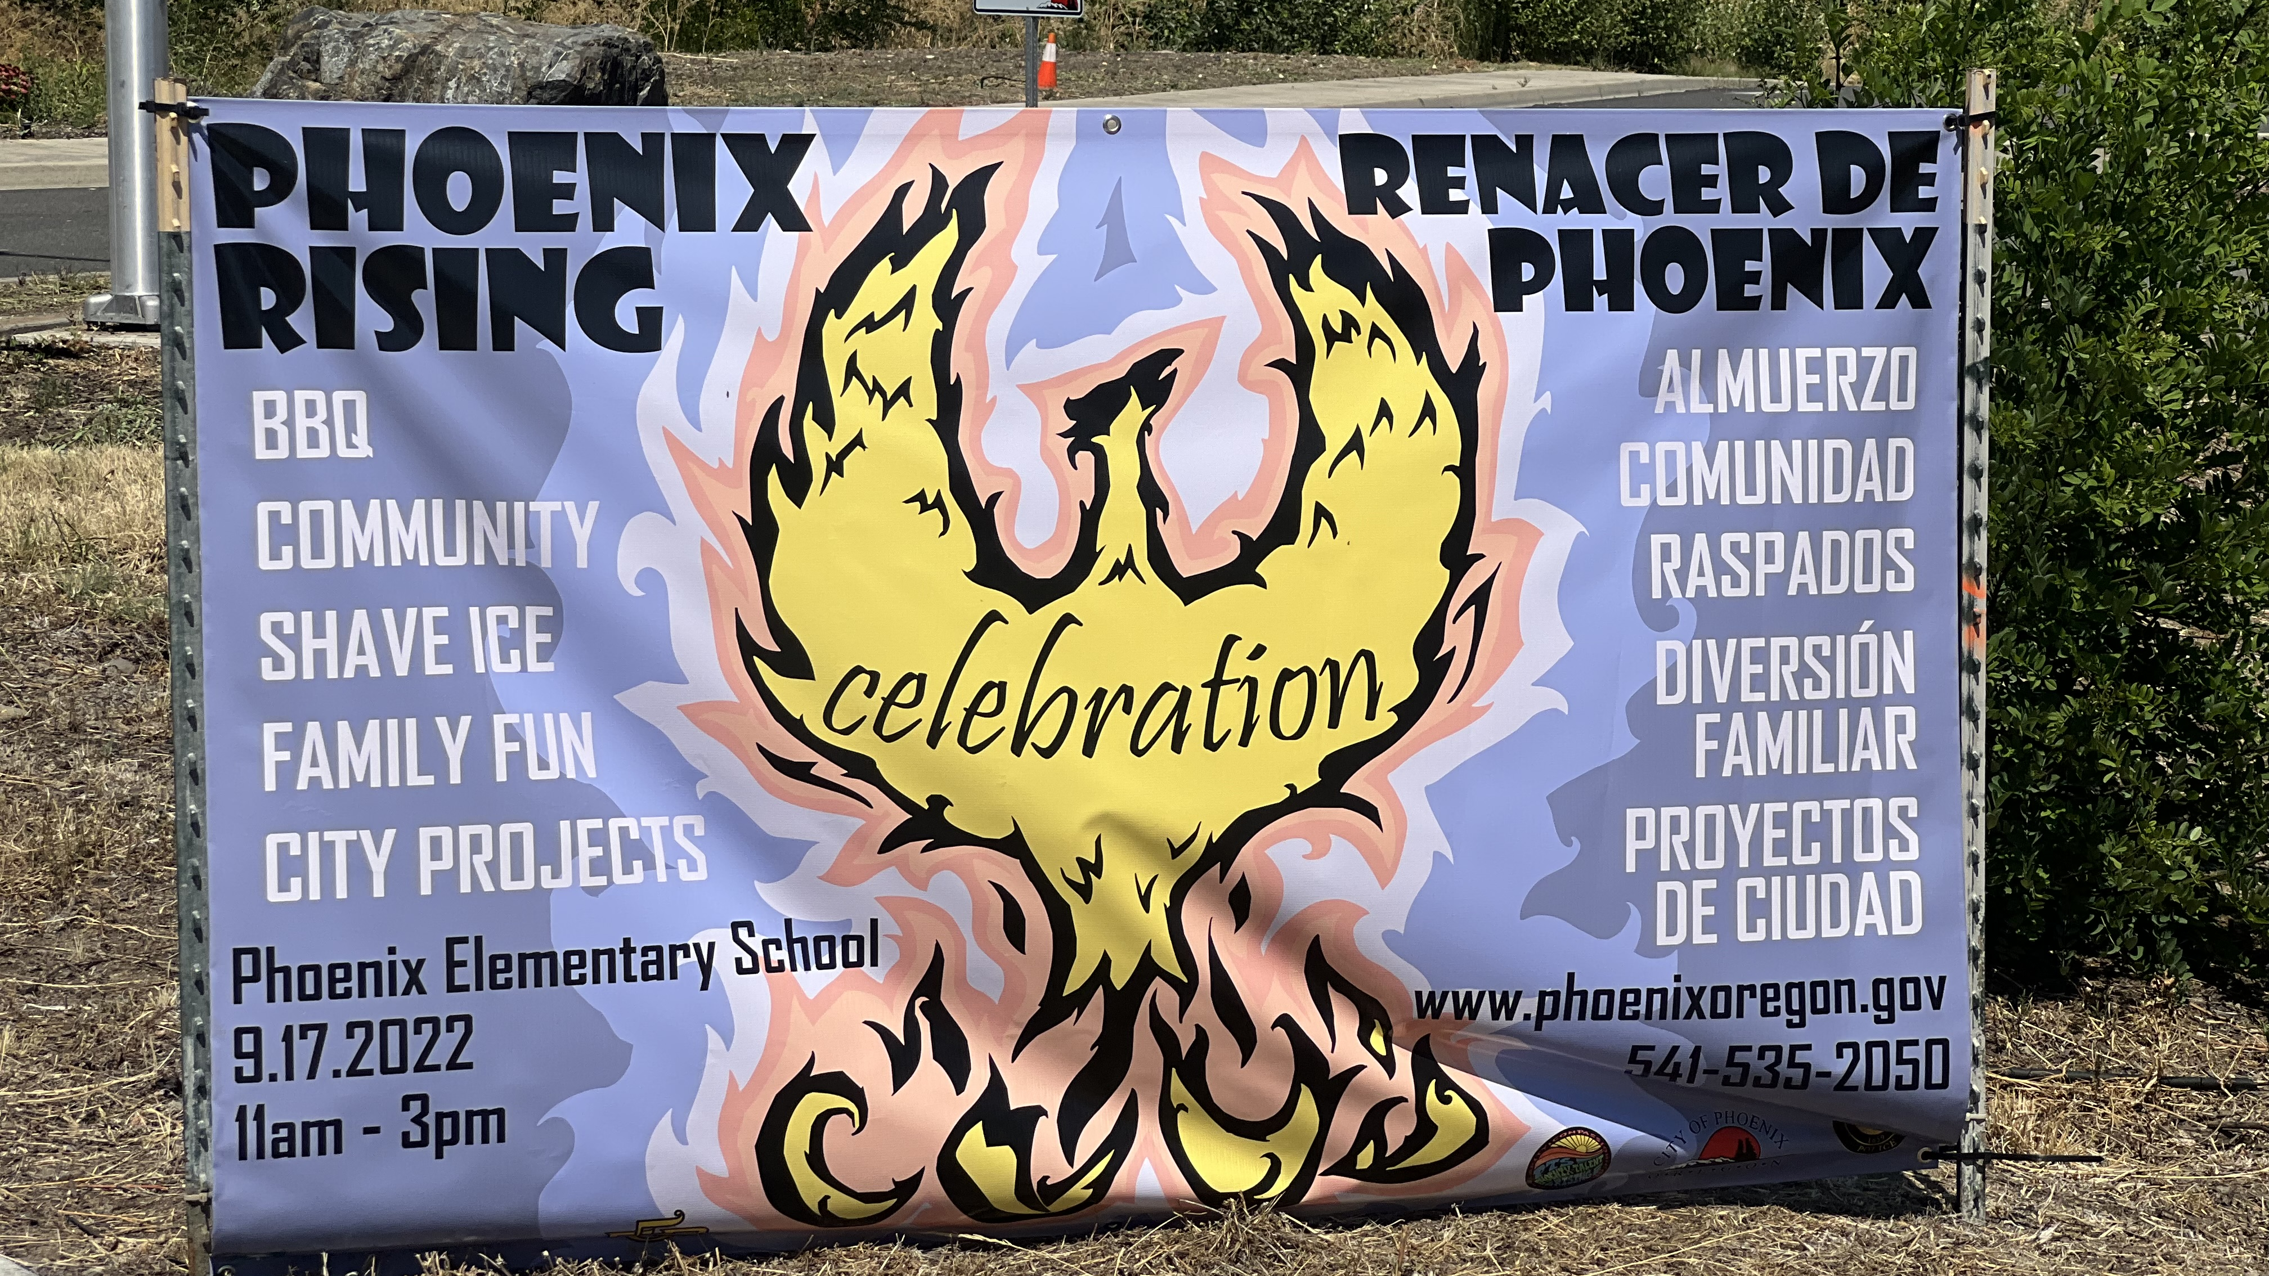
Wildfire and Brownfields
Greg Stabach, Natural Resources
Rogue Valley Council of Governments
Central Point, Oregon

Slide 2
Presentation overview
Regional Brownfield Program
Almeda Fire
Brownfields and Fire impacts
Lessons Learned

Slide 3
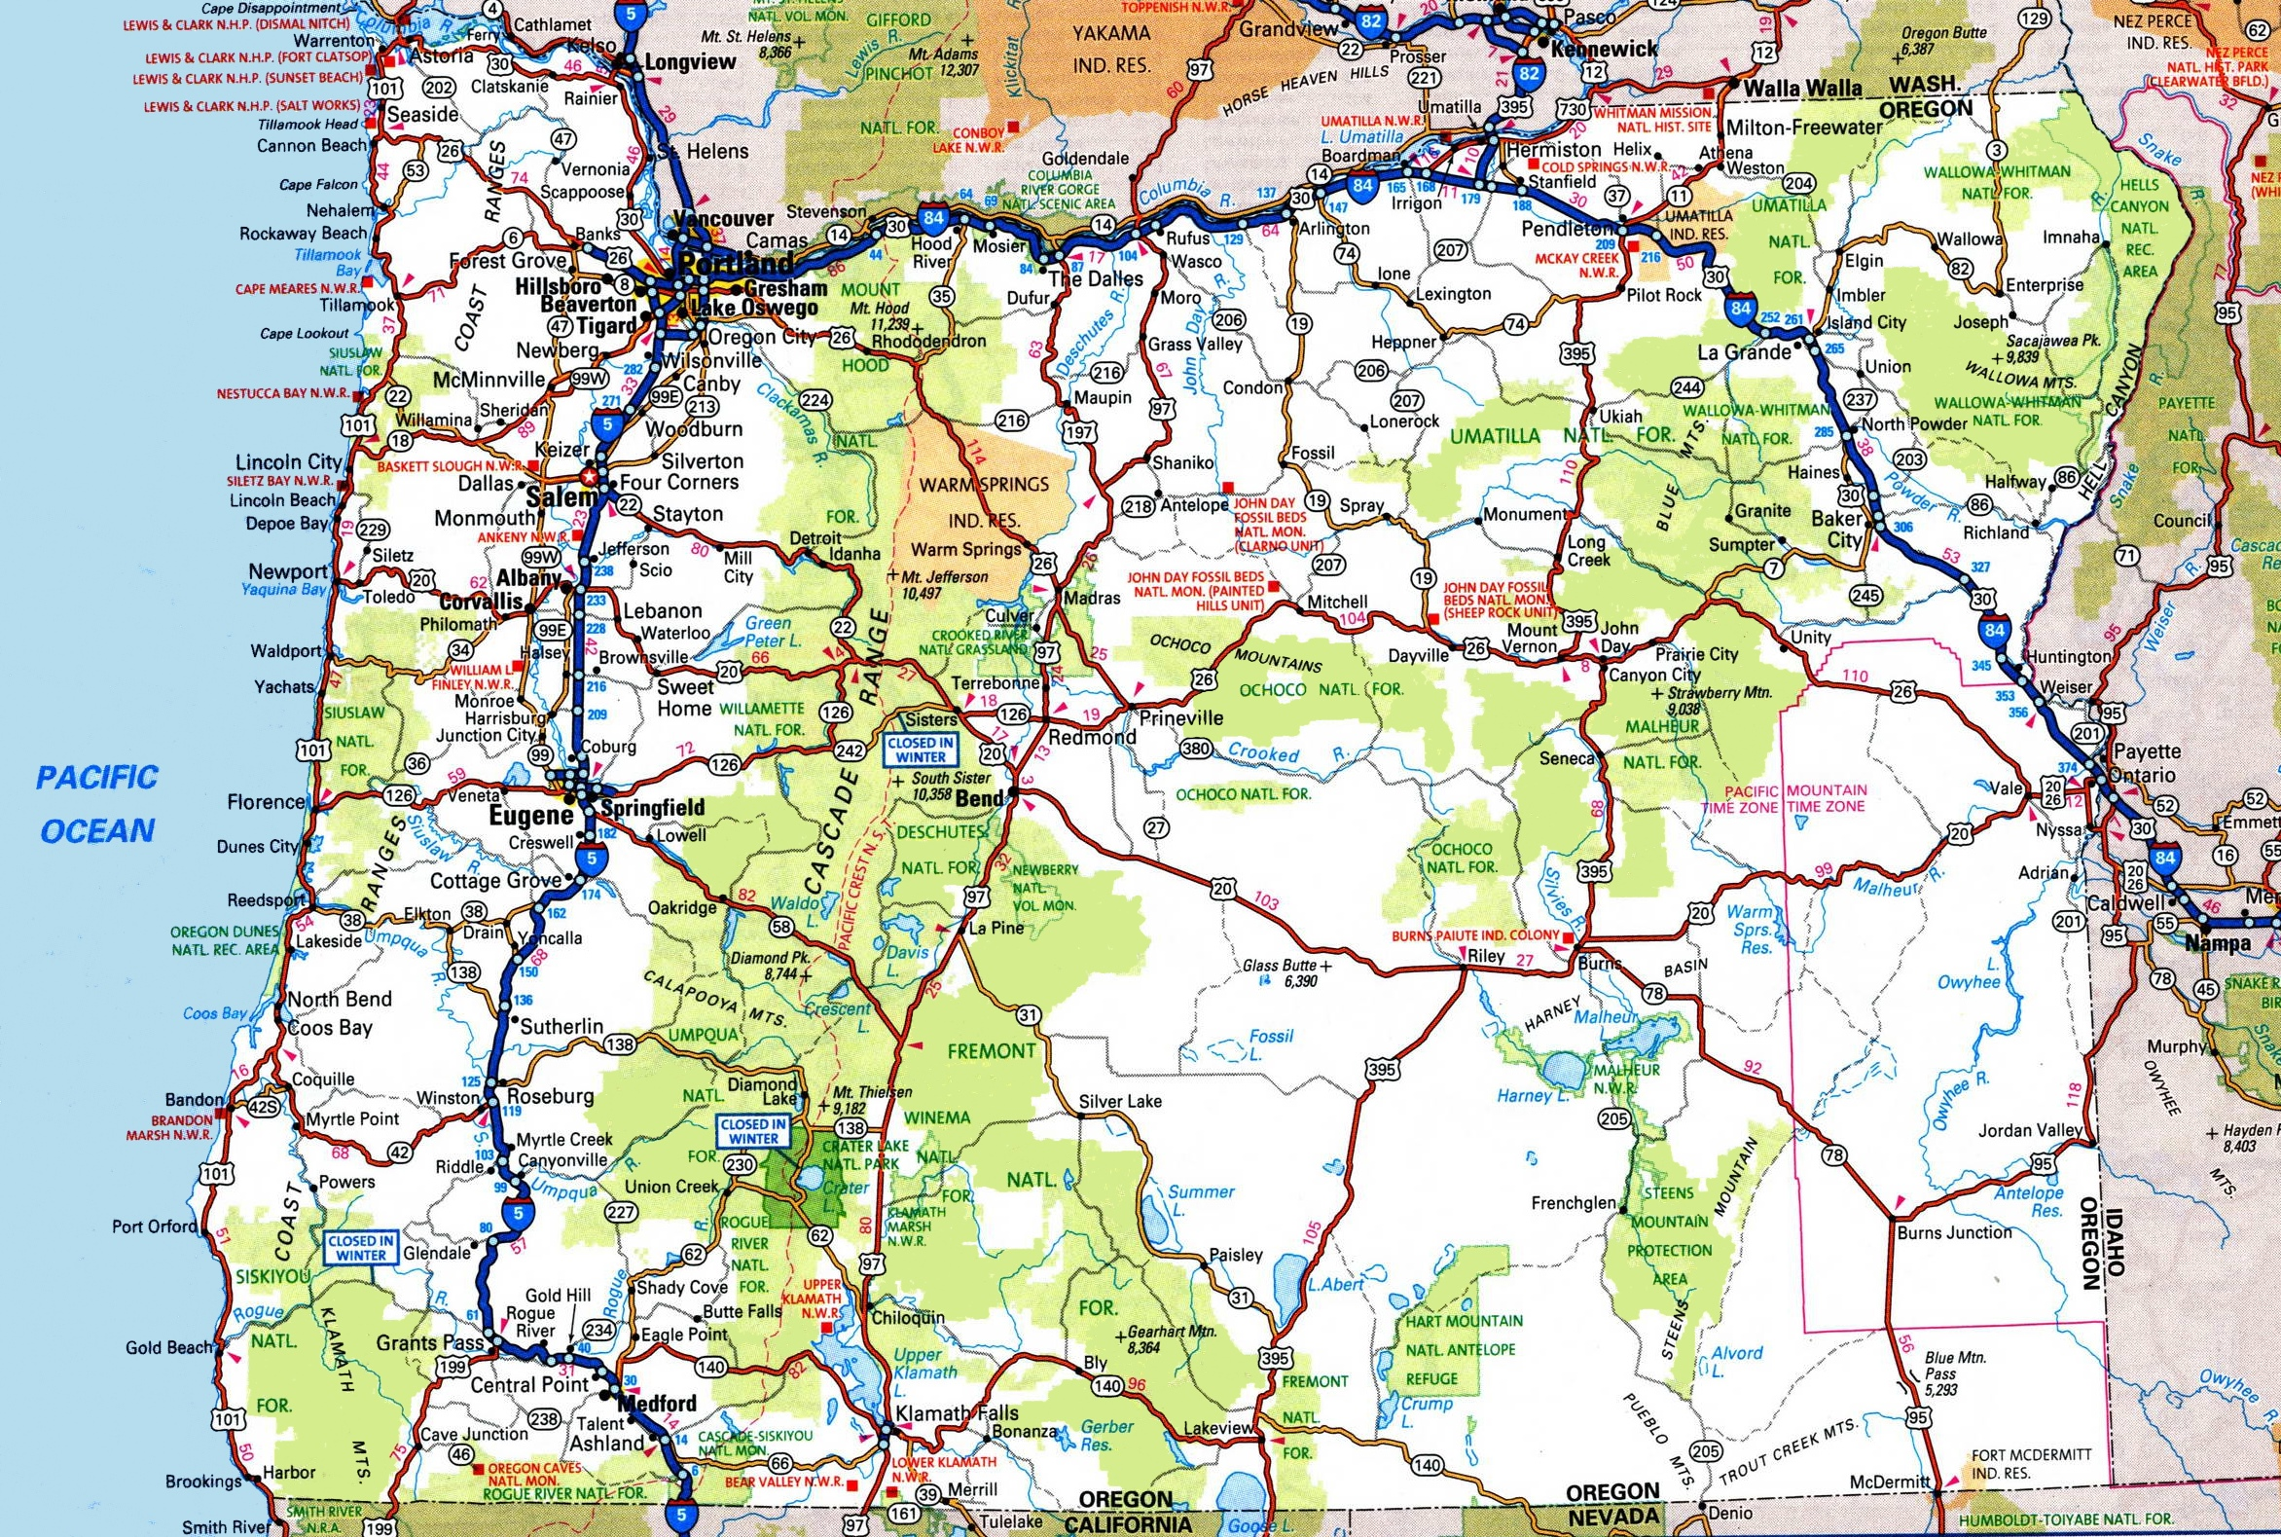

Slide 4
Jackson county - Background
Close to 200,000 residents
Bear Creek most urbanized watershed in Southern Oregon
Agricultural and Tourism
Former timber area
Rogue River
Outdoor activities - Fishing, rafting, hiking

Slide 5
Local Concerns from a changing climate
Fires
Flooding
Disease/Insect Damage
Heat
Snowpack/Water Supply

Slide 6
Observed impacts of a changing climate –my perspective over the last 24 years
Temperatures increasing on average (more days over 100 degrees Fahrenheit)
More frequent fires (lots of fires annually)
More frequent larger fires (large acreage)
Longer fire season
More days with AQI index of over 100
Prolonged droughts leading to water shortages
Erratic flows in streams (erosion and flooding)
Invasive species, insects, and disease

Slide 7
Southern Oregon Brownfield Program
2017–2020
Brownfield Communitywide Assessment 2017-2020
2022–2026
Assessment 2022-2026

Slide 8
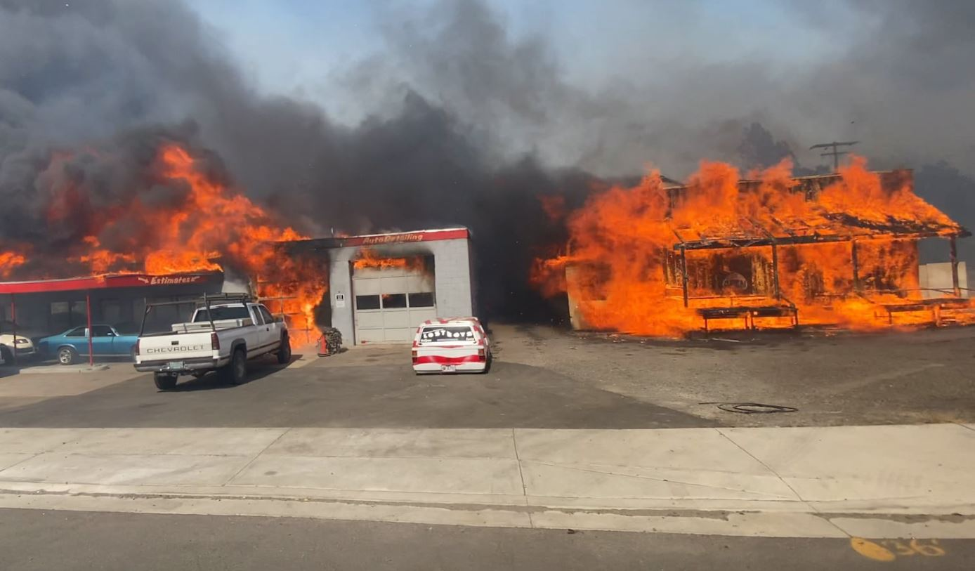
Almeda fire Overview

Slide 9
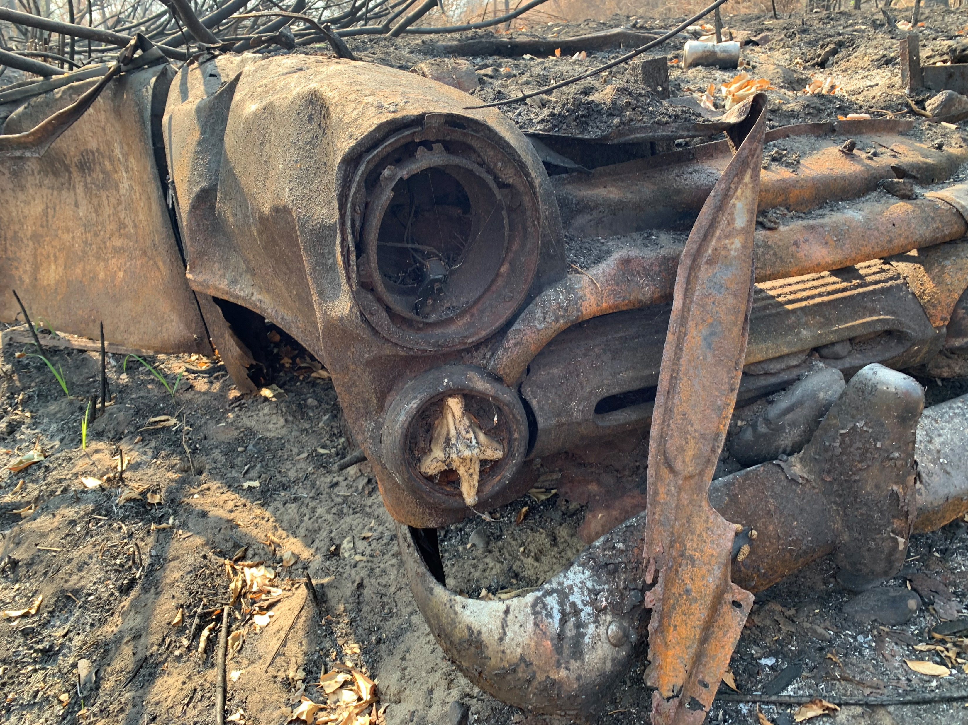
September 8th, 2020
Fire began near Ashland, Oregon
Strong winds drove the fire quickly to the northwest
The path of the fire followed OR-99 through Talent and Phoenix
Wildfire burned for approximately 36 hours
Mandatory evacuations in Ashland, Phoenix, Talent, and Medford
Total length of fire approximately 7 miles
Widespread devastation – homes, businesses, commercial, two downtown areas

Slide 10
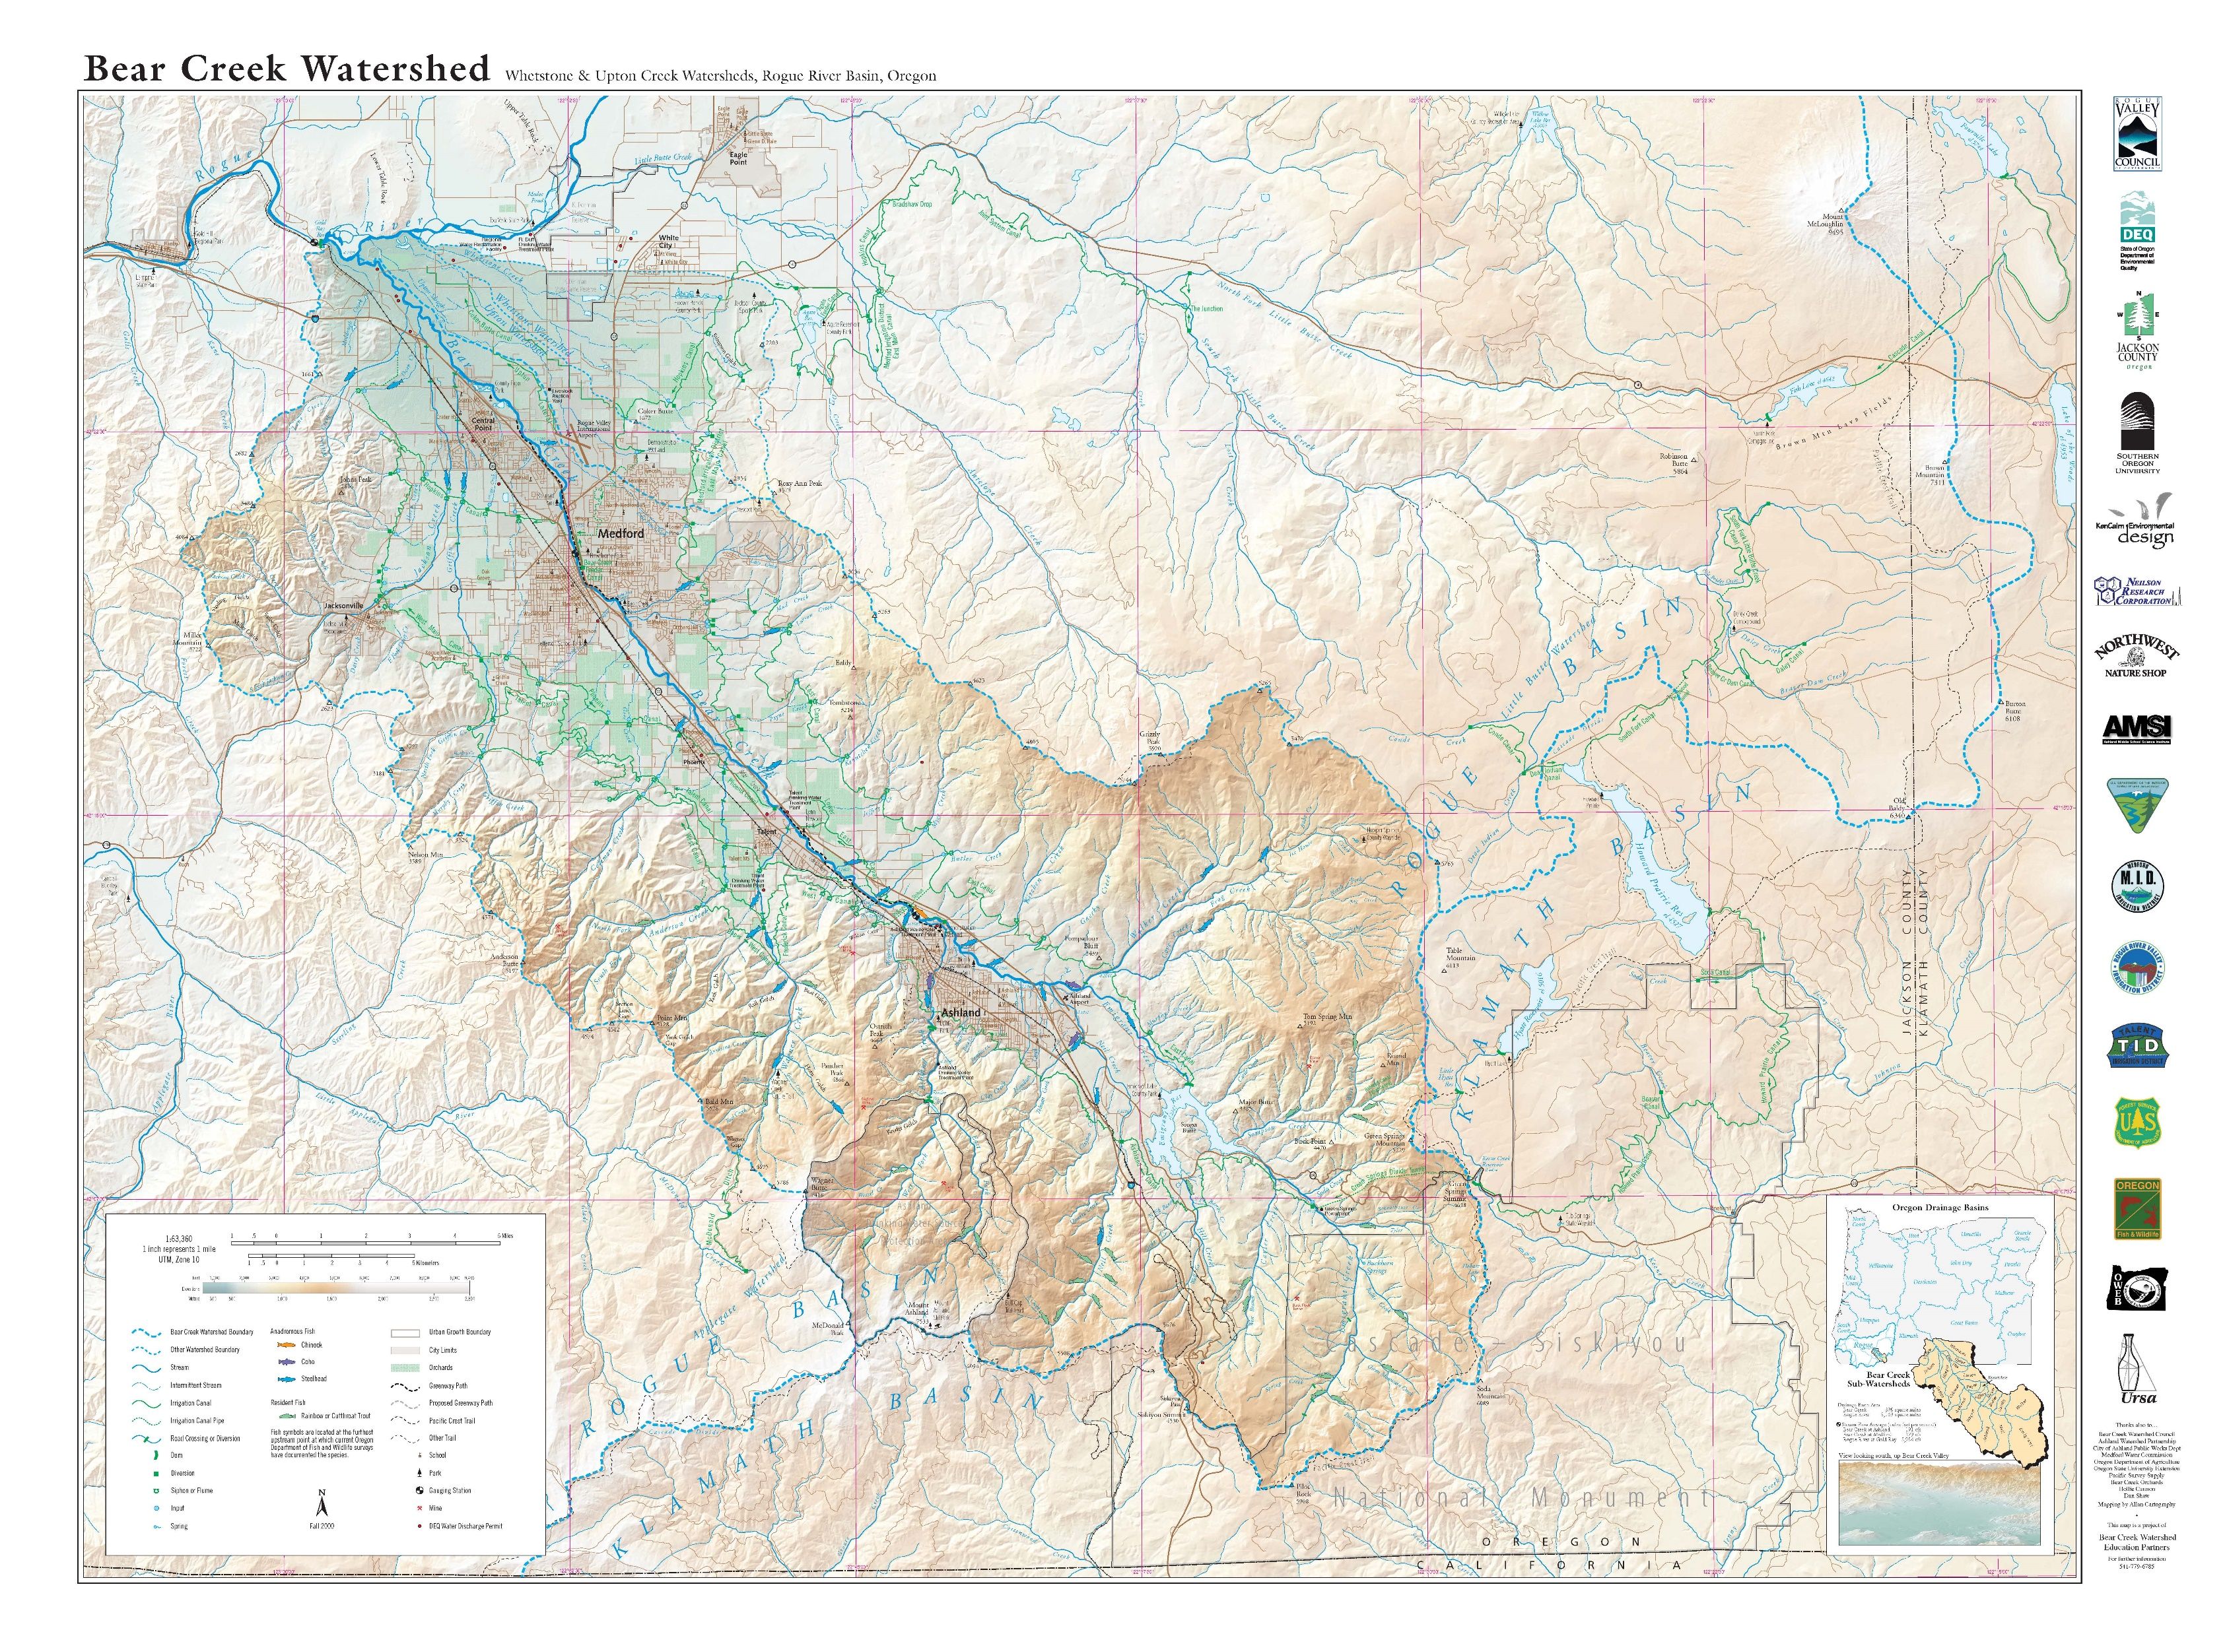

Slide 11
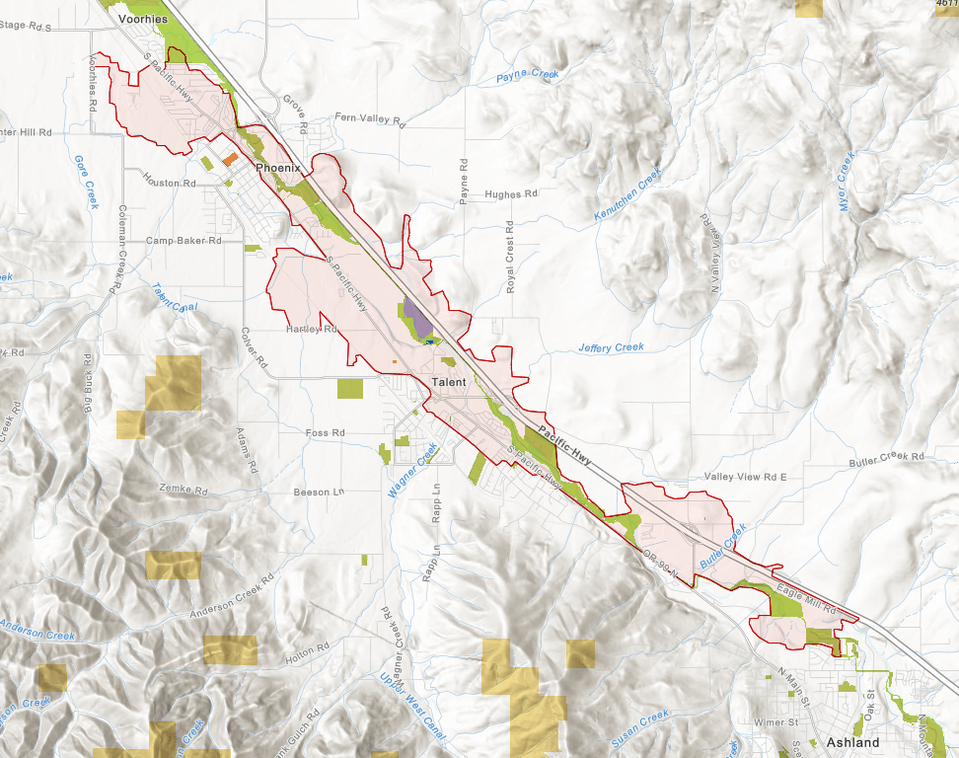
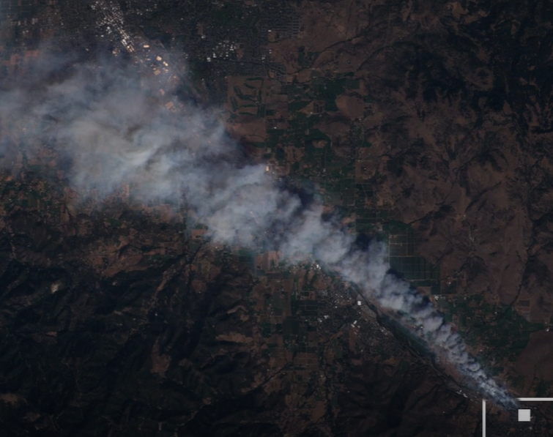

Slide 12
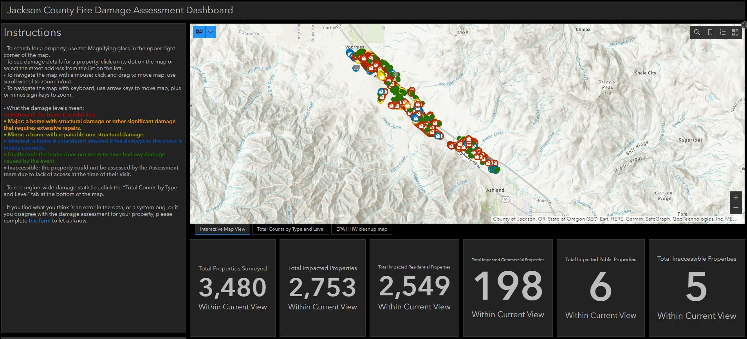

Slide 15
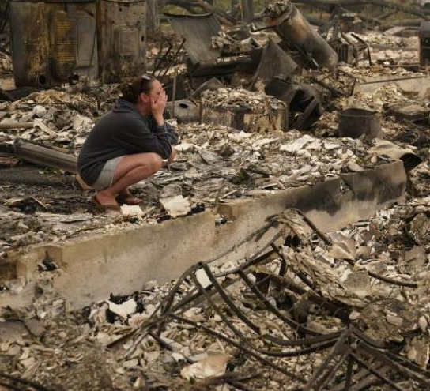
Housing
2,537 homes
18 mobile home parks
4,200 displaced residents
Most of the mobile homes destroyed were serving as unsubsidized affordable housing for low-income residents. More than 3,500 mobile home residents were displaced and included the Rogue Valley’s most vulnerable: low income, the elderly, and Latinx families including many seasonal agricultural and forestry workers.

Slide 16
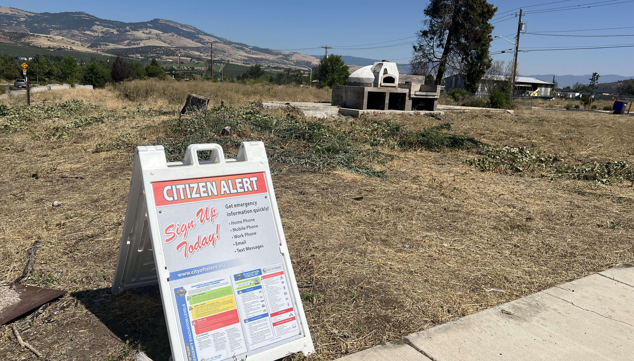
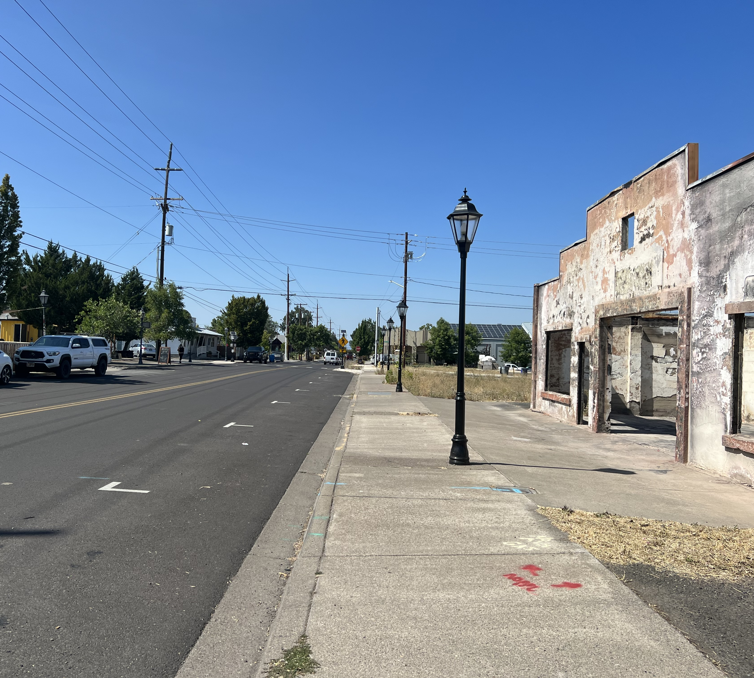
Commercial/ Businesses
171 Business
Portions of downtown Phoenix and Talent
Still recovering and rebuilding 4 years later

Slide 17
Impact #1 - Changed our thinking and priorities For application
Priority – Areas impacted by the fire
Where were new brownfields created?
How were existing brownfield properties impacted?
How could the Brownfields program help with the rebuilding efforts?
What is different process wise? Housing still the greatest need.
Secondary – other areas of Jackson County
Residents concerned but not directly impacted by fire.

Slide 18
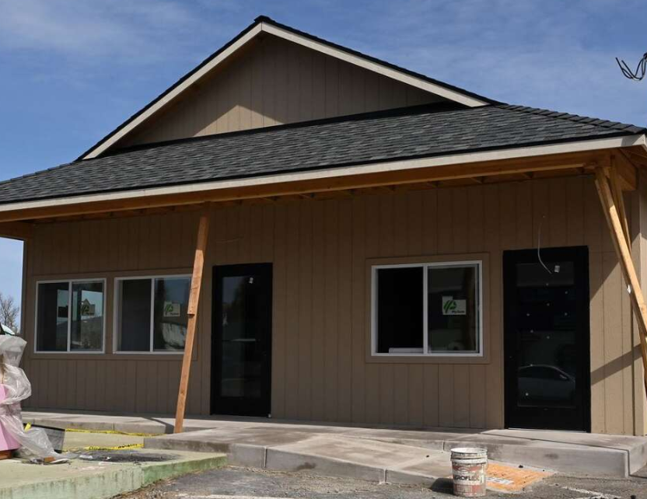
Our Vision
Support recovery efforts (e.g. fire victims)
Increase housing supply, particularly affordable housing
Spur economic development and Real Estate Transactions
Rebuild community
Jobs

Slide 19
Impact #2: New brownfields and brownfields impacted
Revise and update brownfield inventories

Slide 21
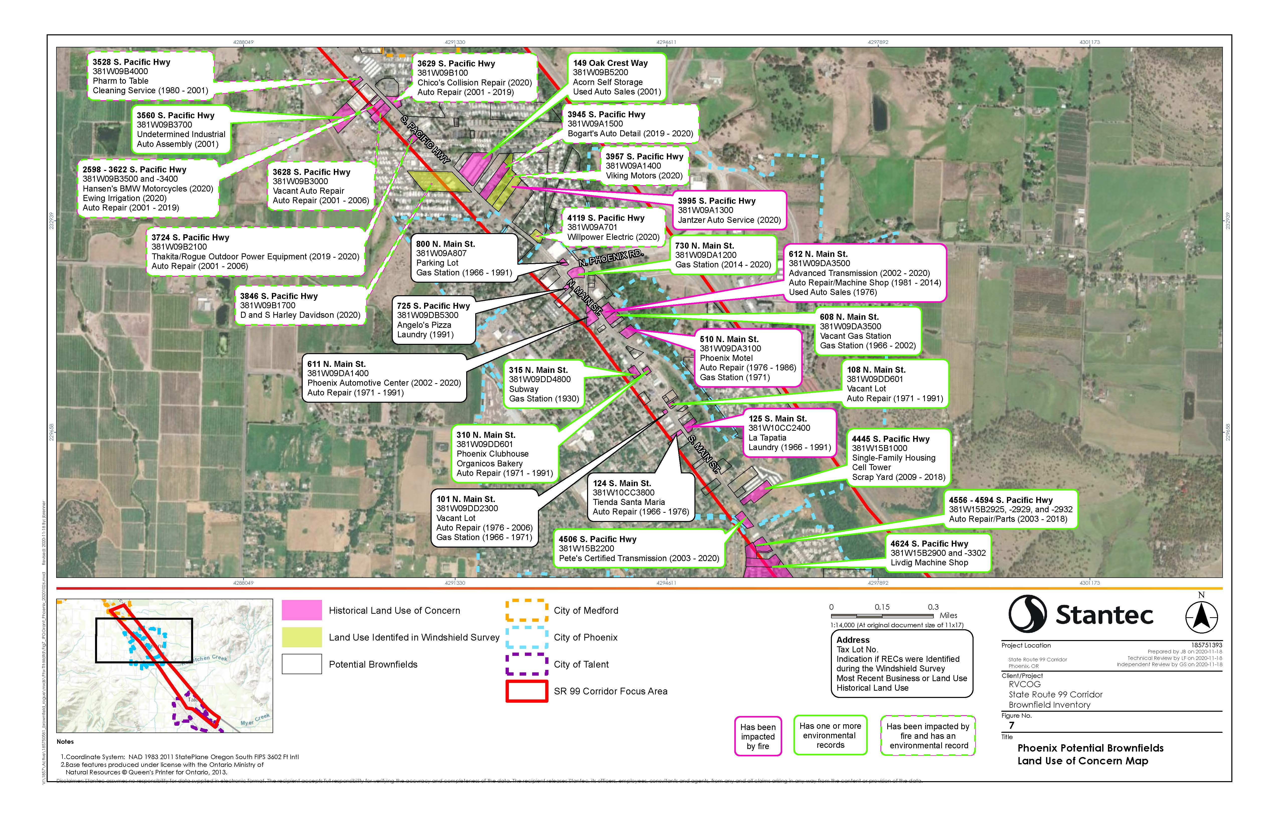

Slide 22
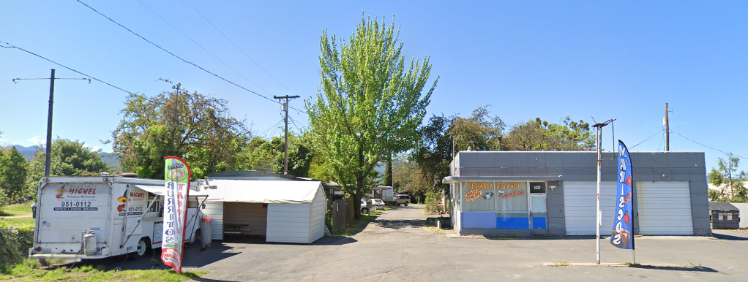
Example Site #1
Former Gas Station
Open Database Listing
Vacant at Time of Fire

Slide 23
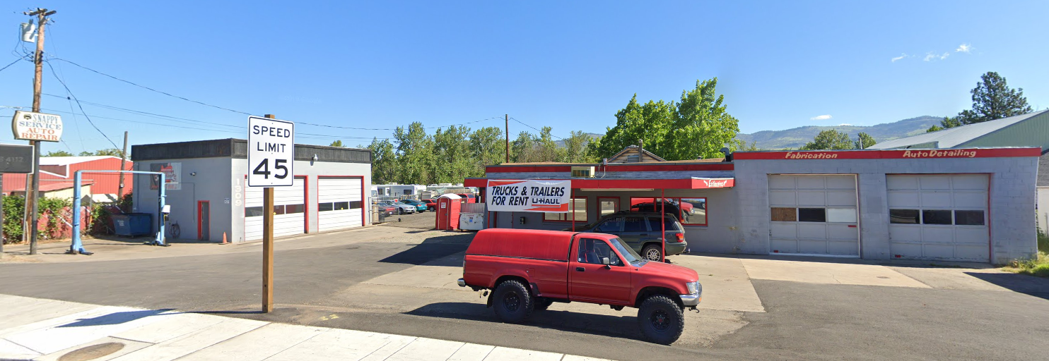
Example Site #2
Former Gas Station and Auto Service
Open Database Listing
Spills Possible During Fire
For Sale

Slide 24
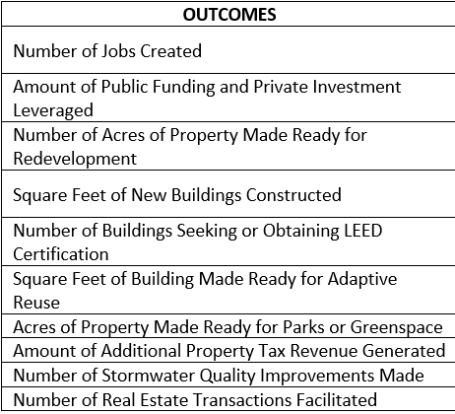
Impact #3 – FIRE AND CLIMATE RESILIENCY PLANNING
DEFENSIBLE SPACE
NEW BUILDING MATERIALS AND METHODS
FIRE BREAKS
WATER
EVACUATION ROUTES
TEMPORARY HOUSING
PUTTING PEOPLE BACK TO WORK
LAND SWAPS

Slide 25
Where we are now? uPDATES
Year 2 of 4
Inventory
Phase 1 and Phase 2’s
Area Wide Planning (preliminary discussions with Talent downtown)
Looking at areas for housing opportunities (affordable, temporary, and permanent)
Working with Phoenix and Talent
Other areas in Jackson County

Slide 26
Lessons learned
Prepare, Prepare, Prepare – Brownfields can help!
Timing – It proved to be difficult to overlap brownfield funding with redevelopment (application process)
Be flexible – Talent Commons
Information sharing/communication– determining the extent of clean-up activities is proving to be a challenge (above vs below ground)
Resources (personnel) spread thin, lots of funding coming in making it tough to coordinate on projects and rebuilding
Institutional hurdles – floodplains, public versus private utilities, mobile home parks, codes

Slide 27
Questions?

Slide 28
Contact Information
Greg Stabach, Natural Resources Program Director
gstabach@rvcog.org
(541) 423-1370
PO Box 3275/155 North First Street
Central Point, OR. 97502

Slide 29
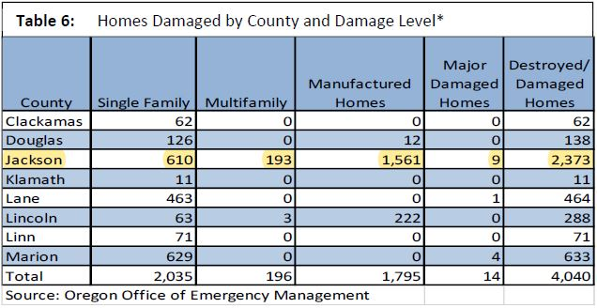

Slide 30
Partners
Brownfields Program
Partners
Pre 2016 – Individual Projects
Inventory (Business Oregon)
Coalition Community Wide Assessment Program 2017-2020
Post Fire Inventory (Business Oregon)
Community Wide Assessment Grant (2022-2026)
Phoenix*
Talent*
Central Point**
Medford
Jackson County*
Grants Pass (Coalition grant only)

