Slide 1
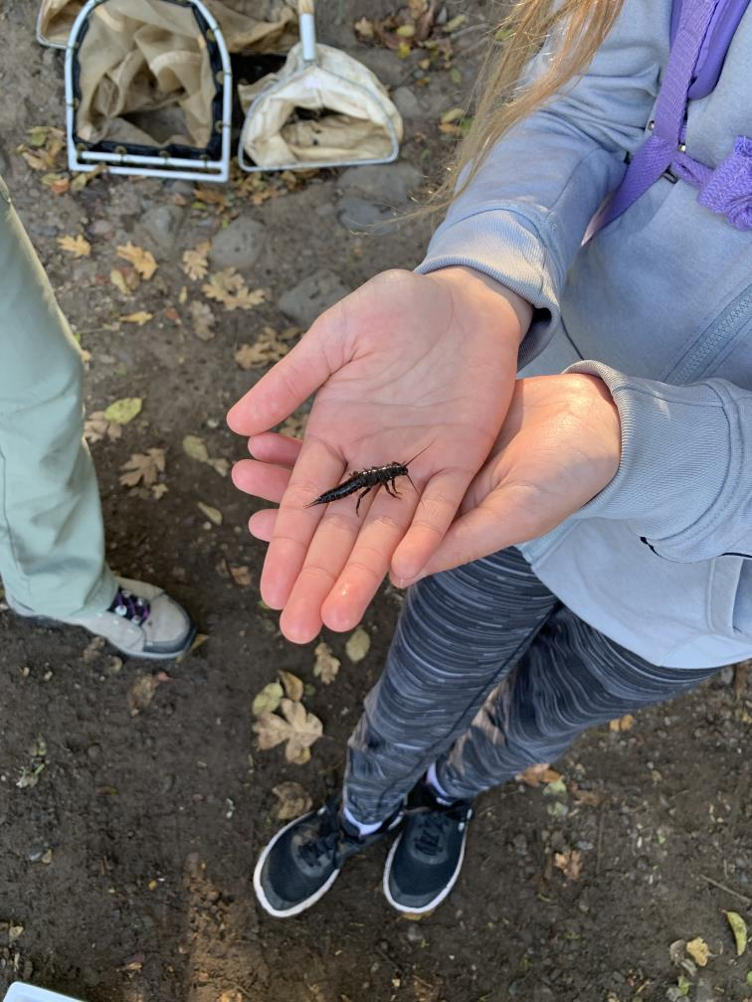
Salmon Watch Program Overview
Greg Stabach, RVCOG
Central Point Rotary
August 3rd, 2022

Slide 2
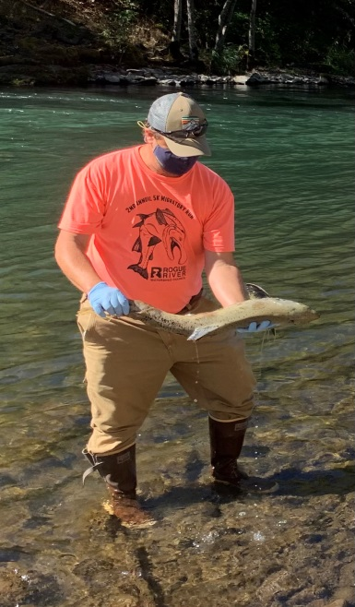
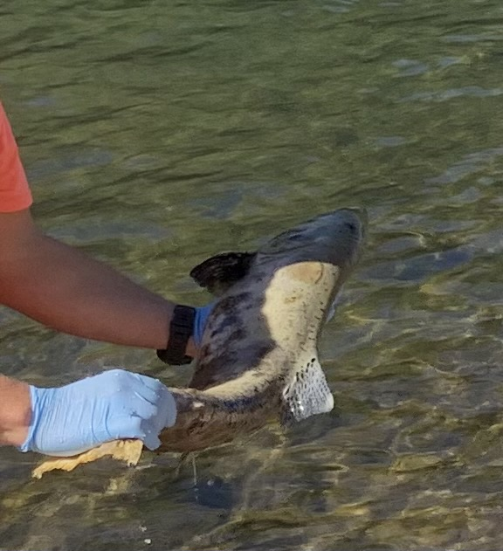
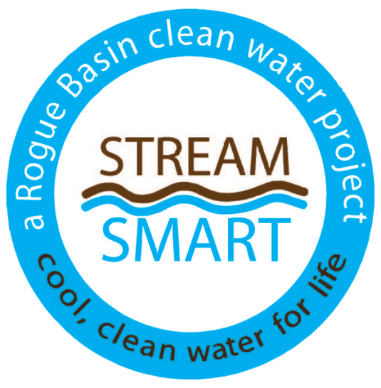
My Background
Hydrologist
22 years working in the Rogue Basin
Involved with Salmon Watch since 2006?

Slide 3
Presentation Overview
What is Salmon Watch?
Program History
Program Elements (detail)
Funding
Resources

Slide 4
What is Salmon Watch?

Slide 5
A way to teach students about watershed health from the salmons perspective
Notes:
What’s important to Salmon

Slide 6
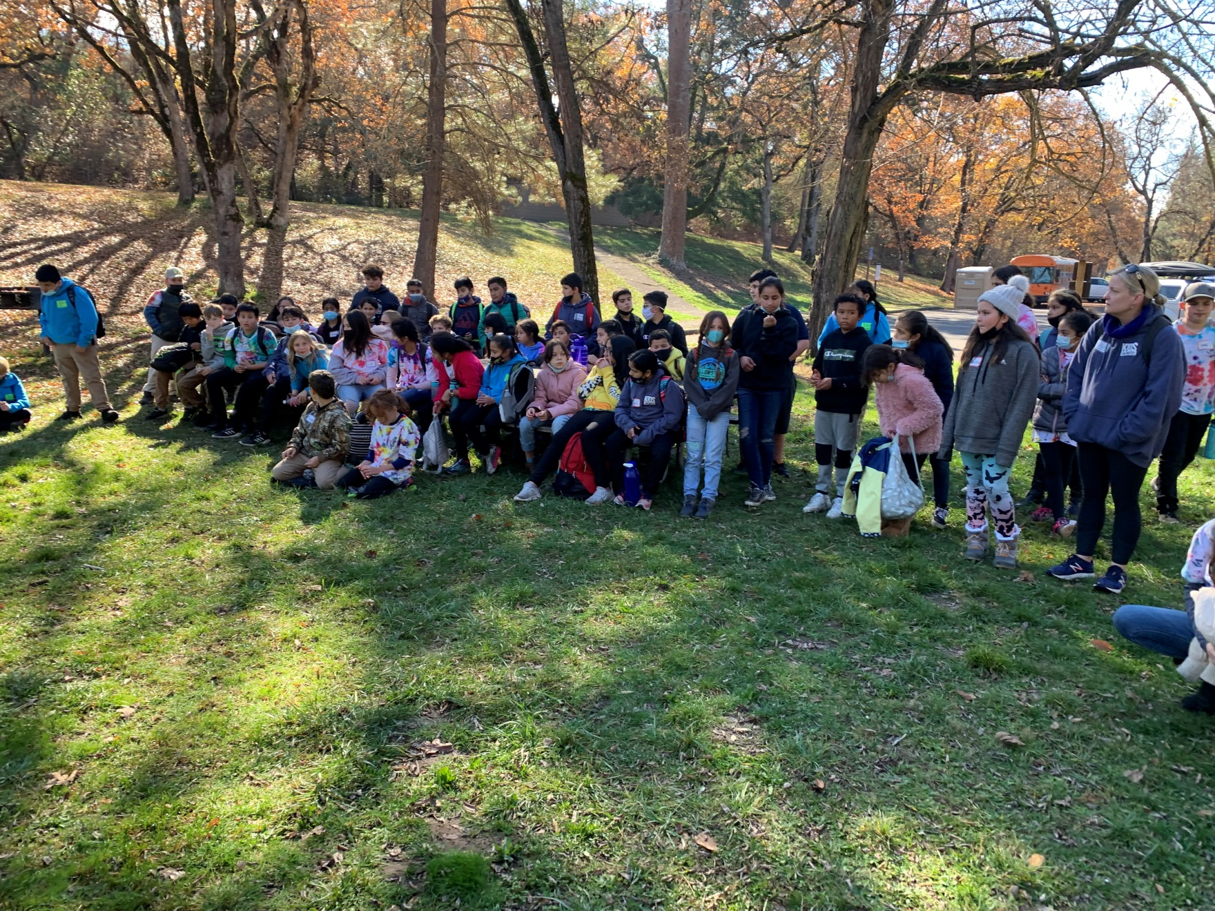

Slide 7
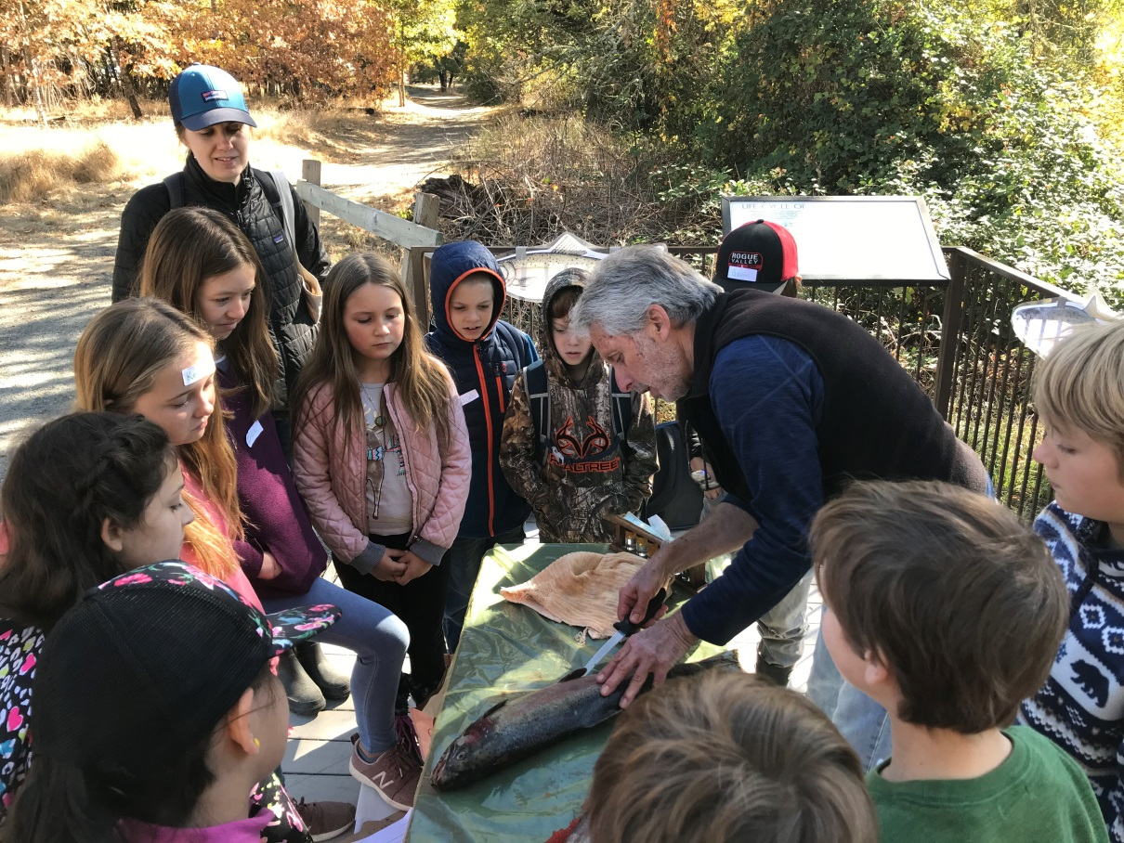

Slide 8
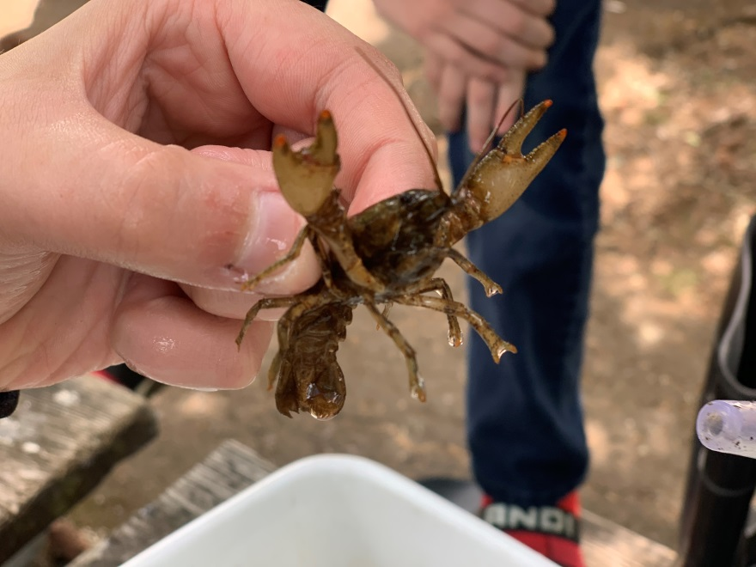
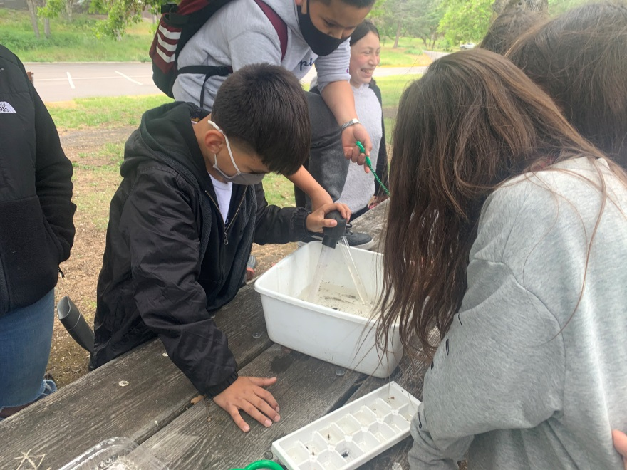

Slide 9
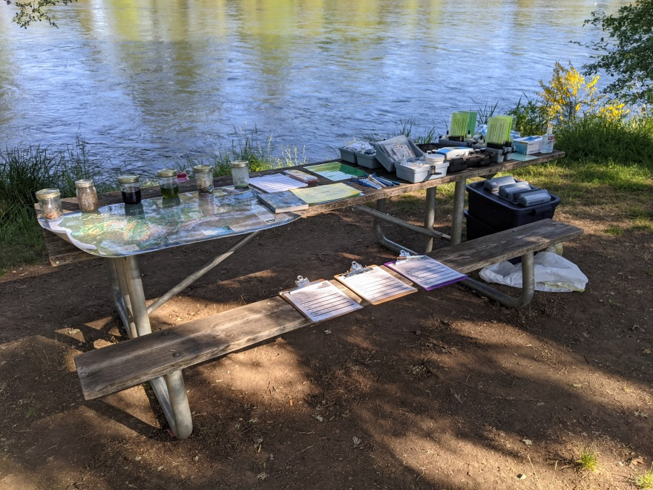
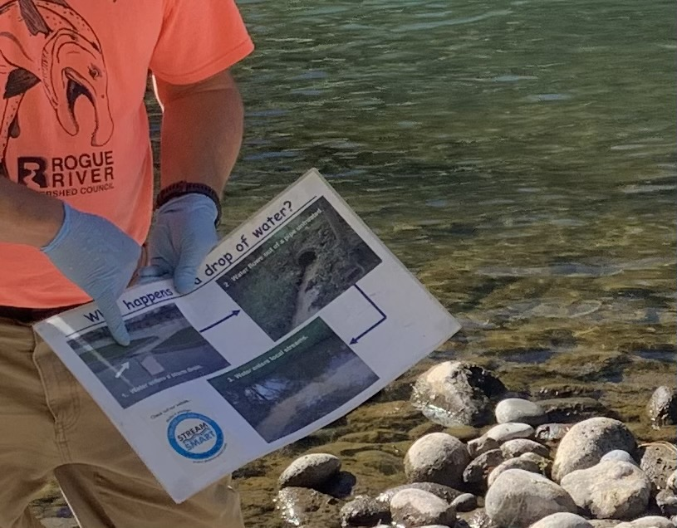

Slide 10
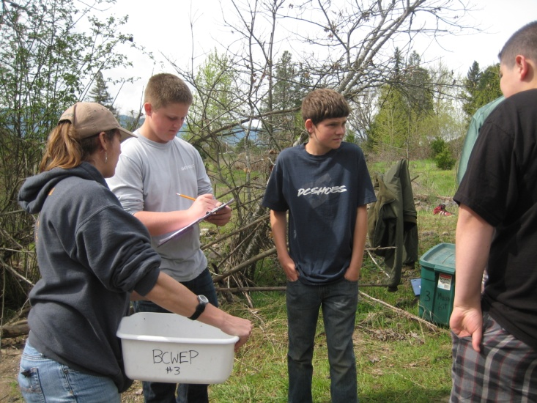

Slide 11
Program History
Established in 2003 by Oregon Trout
Curriculum designed to meet STEM standards
Program ran locally from 2003-2009 – The Freshwater Trust, Coyote Trails, Bear Creek Watershed Education Partners
Gap from 2009-2014 (5 years, no funding)
Re-established in 2014 as the current program with local support from Clean Water Act Programs

Slide 12
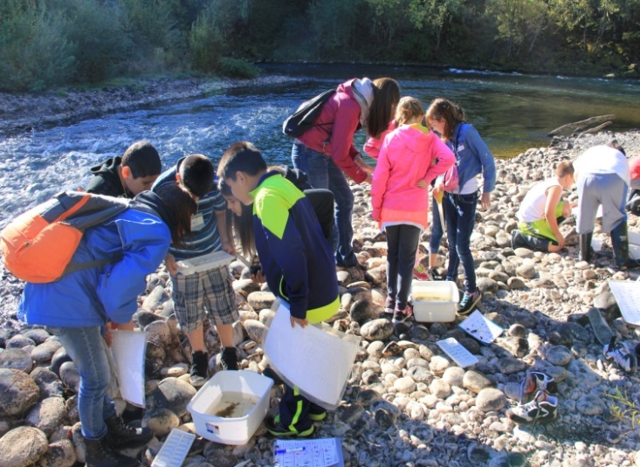
Focus is on Students from local schools
3rd-8th graders*
High School
Mae Richardson, Scenic Middle School – 250 Central Point students (approximately 20%)

Slide 13
Learn from local experts who work in the field

Slide 14
Program Elements:
Field Trips
Hands-On-Activities
Interactive Programs
Virtual Sessions
Classroom Presentations
Service Learning Projects (Scenic Middle School – active restoration, growing plants)
Surveys

Slide 15
Salmon Watch
A program to learn about watershed health, water quality, and stewardship by connecting how each of these components are important to salmon.
Base Question
Do Salmon like to live in area streams? Why or Why not?
Students get to be scientists and test hypothesis.

Slide 17
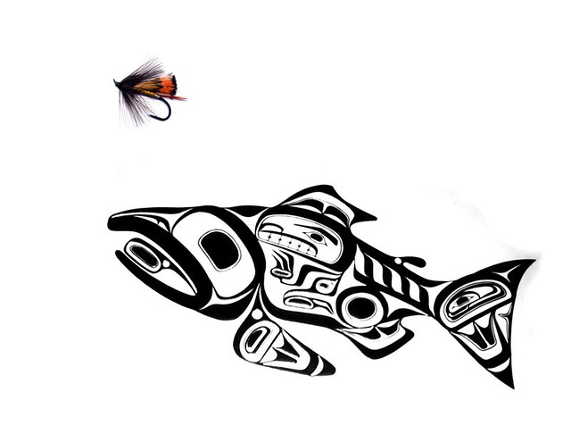
How does it work?
Salmon Biology
Macroinvertebrates
Water Quality
Riparian areas
Notes:
Start at 1, will get through all 4.

Slide 18
Salmon Biology Module
Types of salmon
Salmon life cycle
Behavior¹
See Salmon in Stream¹
Dissection²

Slide 19
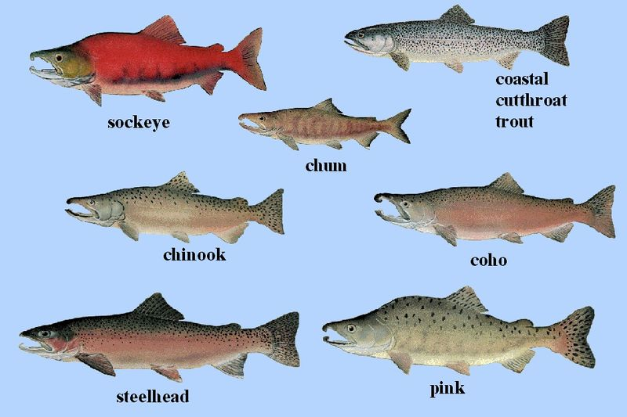
Types of Salmon

Slide 21
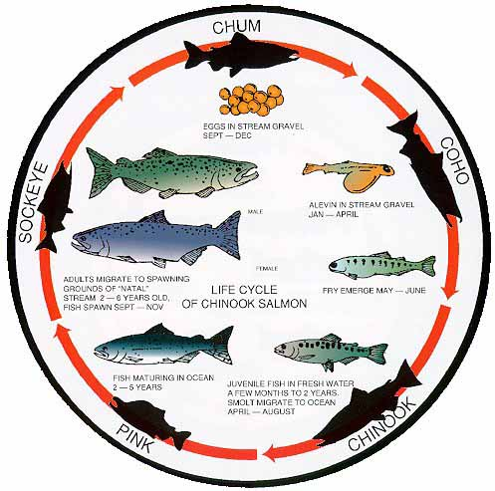
2 spawners
10 adults
200 smolts to sea
800 fry hatch
4000 eggs laid
Notes:
Life cycle

Slide 22
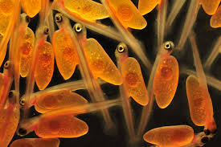
Alevin:
Alevin are newly hatched fish. They derive their nourishment from the yolk sac of the egg from which they were born. Nourishment is provided by the yolk sac for several weeks. They stay in the river gravel until the sac is absorbed.

Slide 23
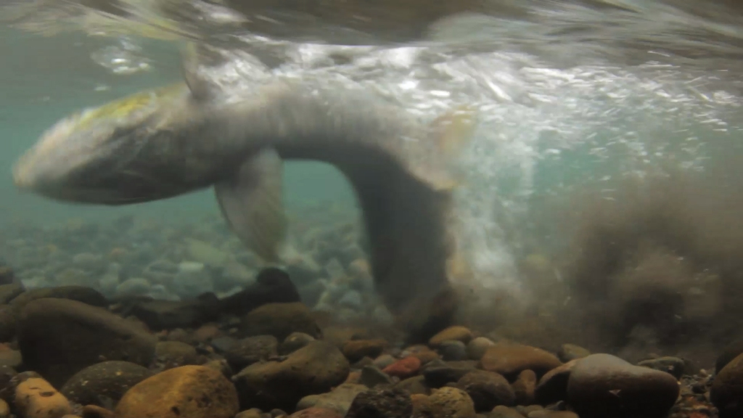
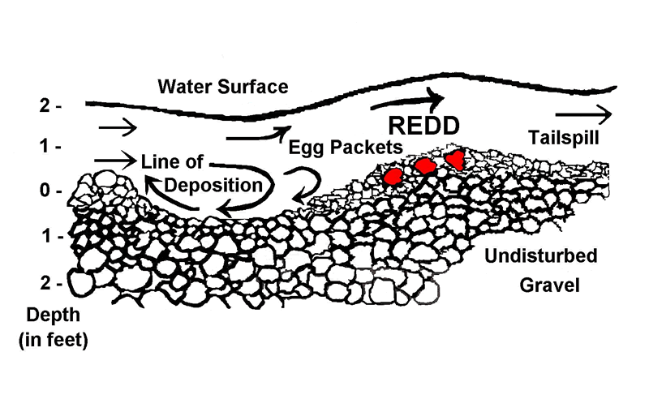
Redd:
a nest dug by salmon and steelhead to deposit eggs. It is formed by the female
using her tail to dig in a small area of gravel in the bottom of the stream .
Notes:
Behavior

Slide 24
Dissection

Slide 25
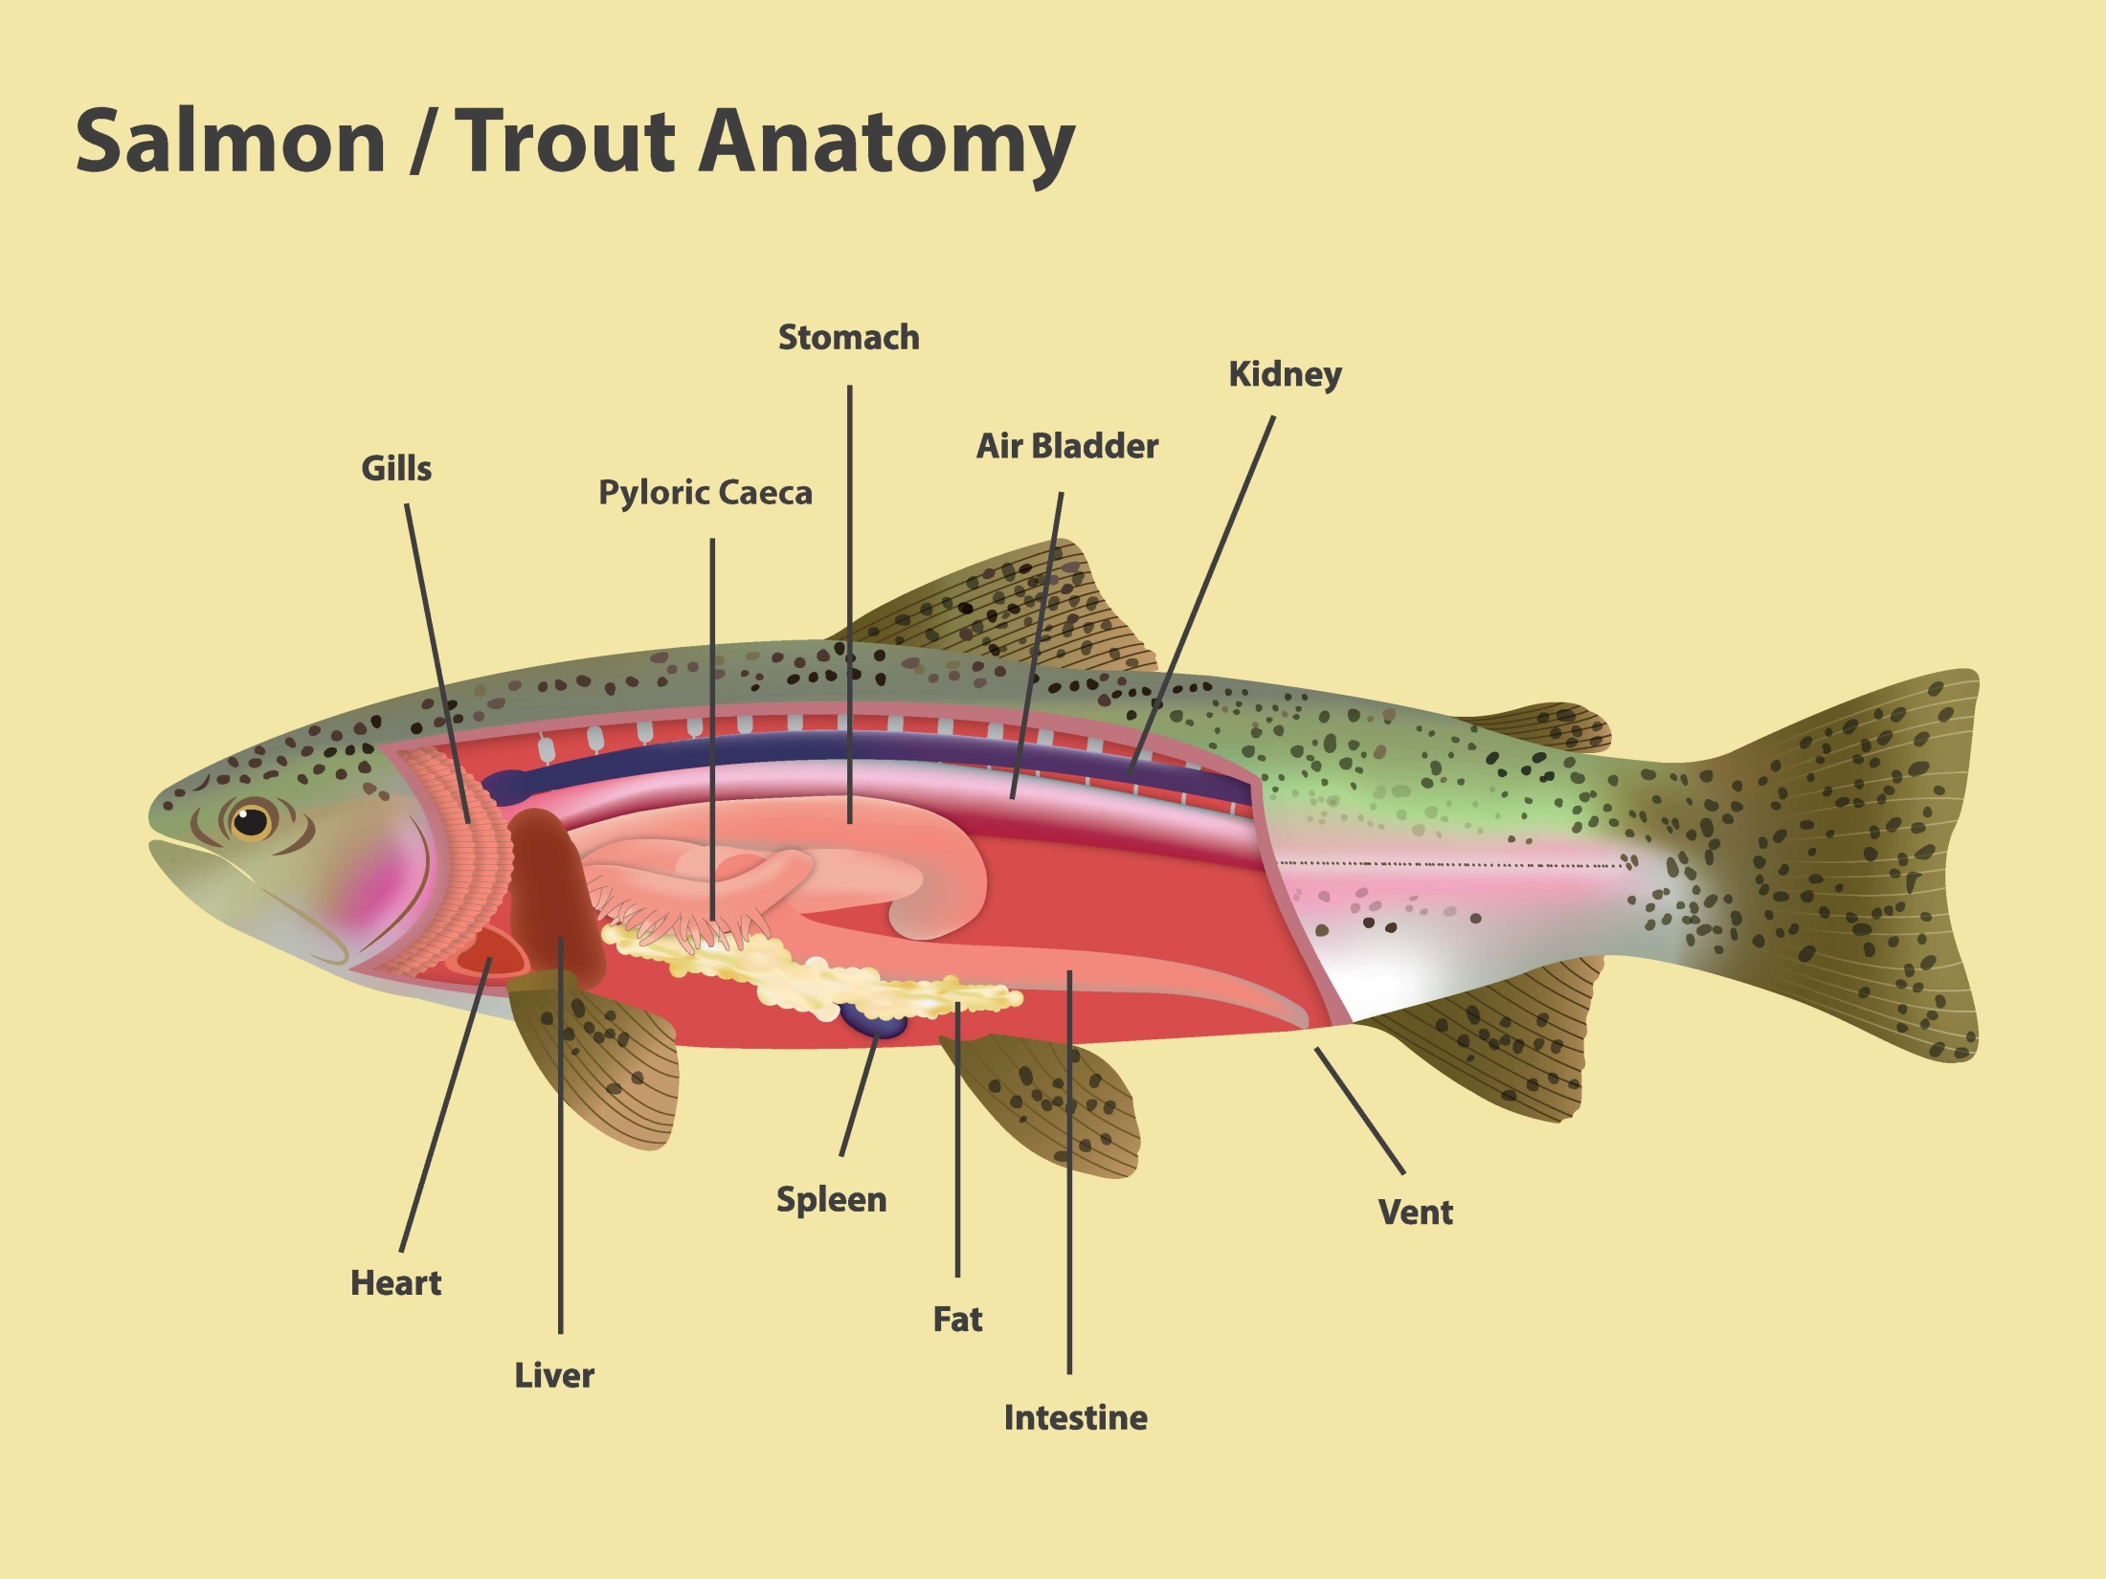

Slide 26
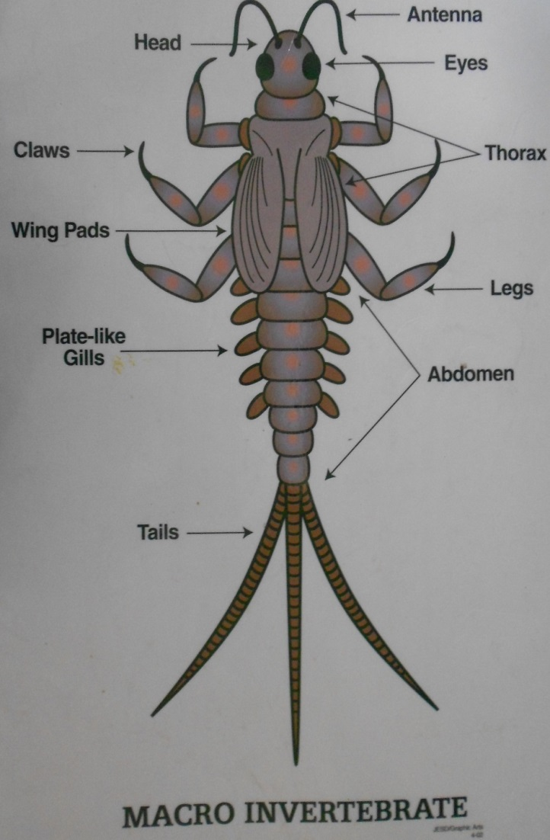
Macro Invertebrate Module
Macro – can be seen with the eye
Invertebrate – Lack a backbone

Slide 27
Importance
Provide food for salmon (young)
Can tell us about water quality (pollution tolerance index)
Lots of different functions/roles in the ecosystem

Slide 28
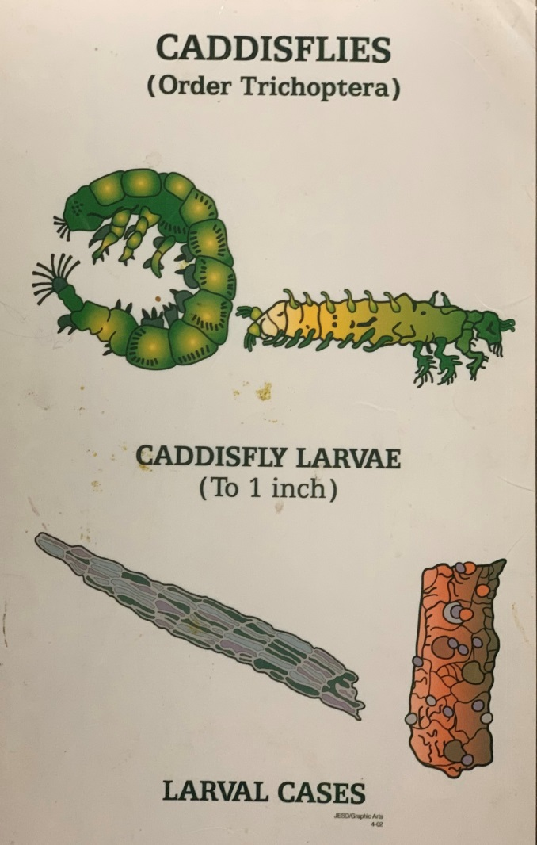
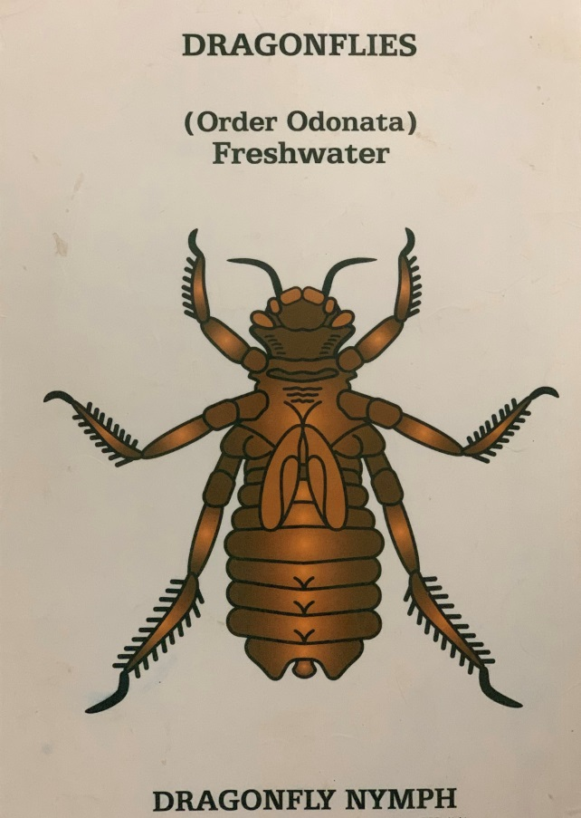
Examples of what you might see

Slide 29
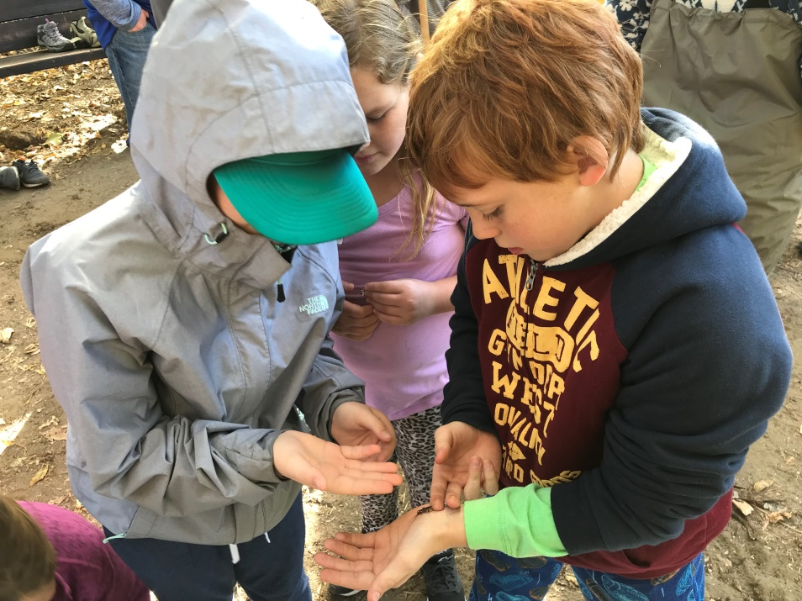

Slide 30
Macro field sheet

Slide 31
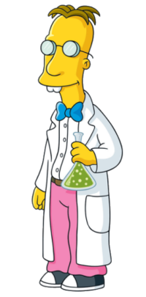
Water Quality Module
Test the water quality to see if its good for fish and macroinvertebrates
Temperature – warm or cold?
Dissolved Oxygen – color change
pH – color matching

Slide 35
Riparian Areas Module

Slide 37
Importance of Trees
Shade
Oxygen
Roots!
Habitat
Ties to local restoration programs

Slide 38
Activity Example

Slide 39
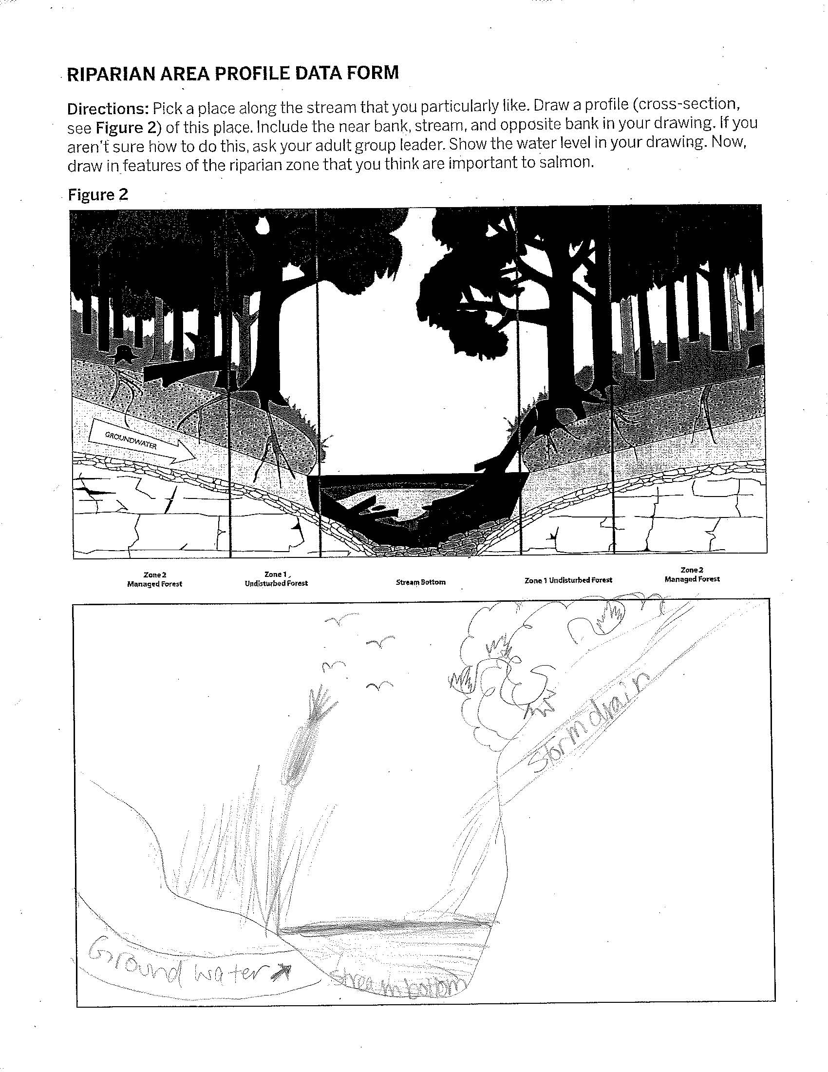
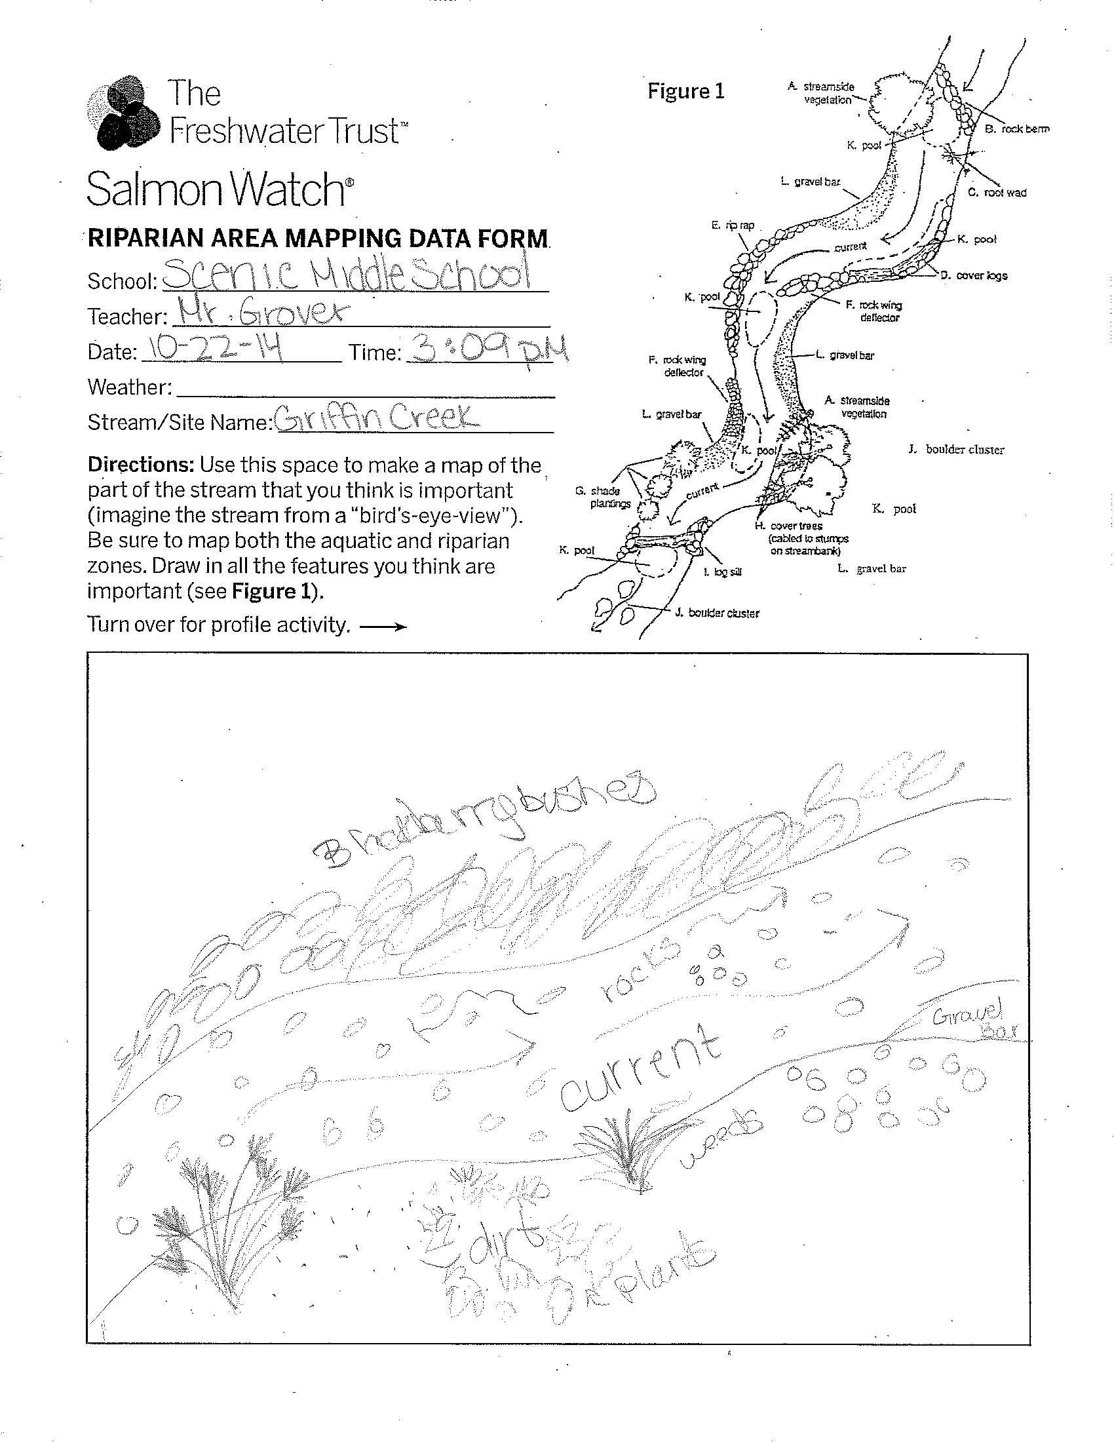

Slide 40
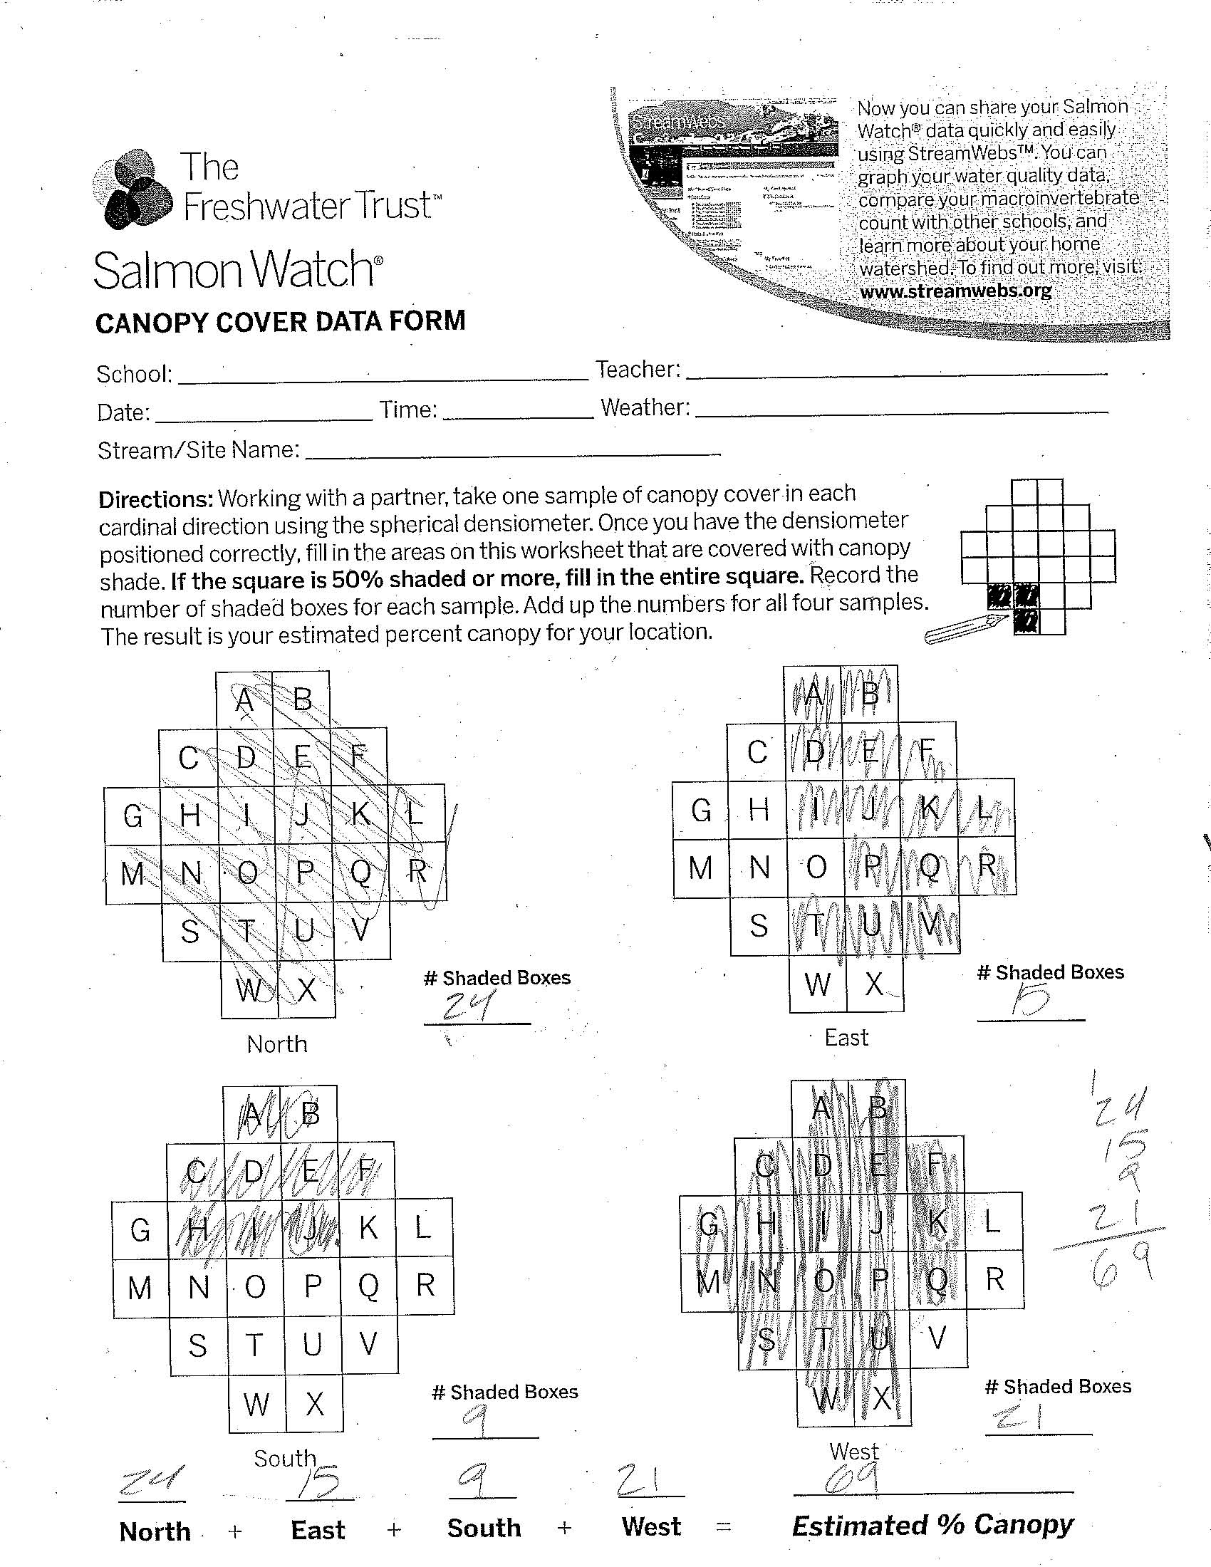
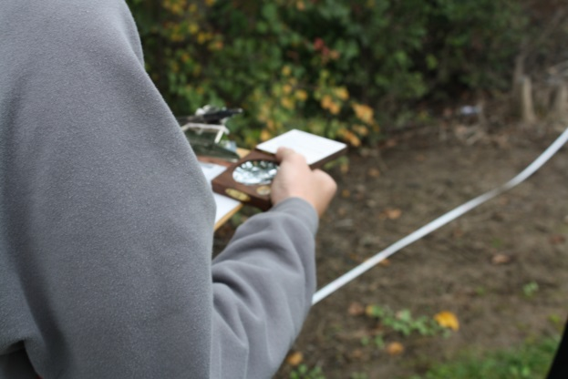

Slide 41
Did students learn?
Scenic Middle School Survey:
Pre-survey results averaged 34% correct answers and the post-survey averaged 70%, resulting in a 105% increase in correct answers.

Slide 42
Funding Support (Rotary)
Contracted Educators
Environmental Education Students (SOU/RCC)
Recent graduates
Transportation (McGregor Park, Tou Velle)
Supplies

Slide 43
Match Funding
Local Clean Water Act Programs
Coordination and Scheduling (logistics)
Training
Module Instruction
Administration
Partners, Partners, Partners
Module Instruction
Fee waivers
Materials

Slide 44
For more information
https://www.stream-smart.com/our-work/programs-and-projects/rogue-basin-salmon-watch/

Slide 45
Questions?

Slide 46
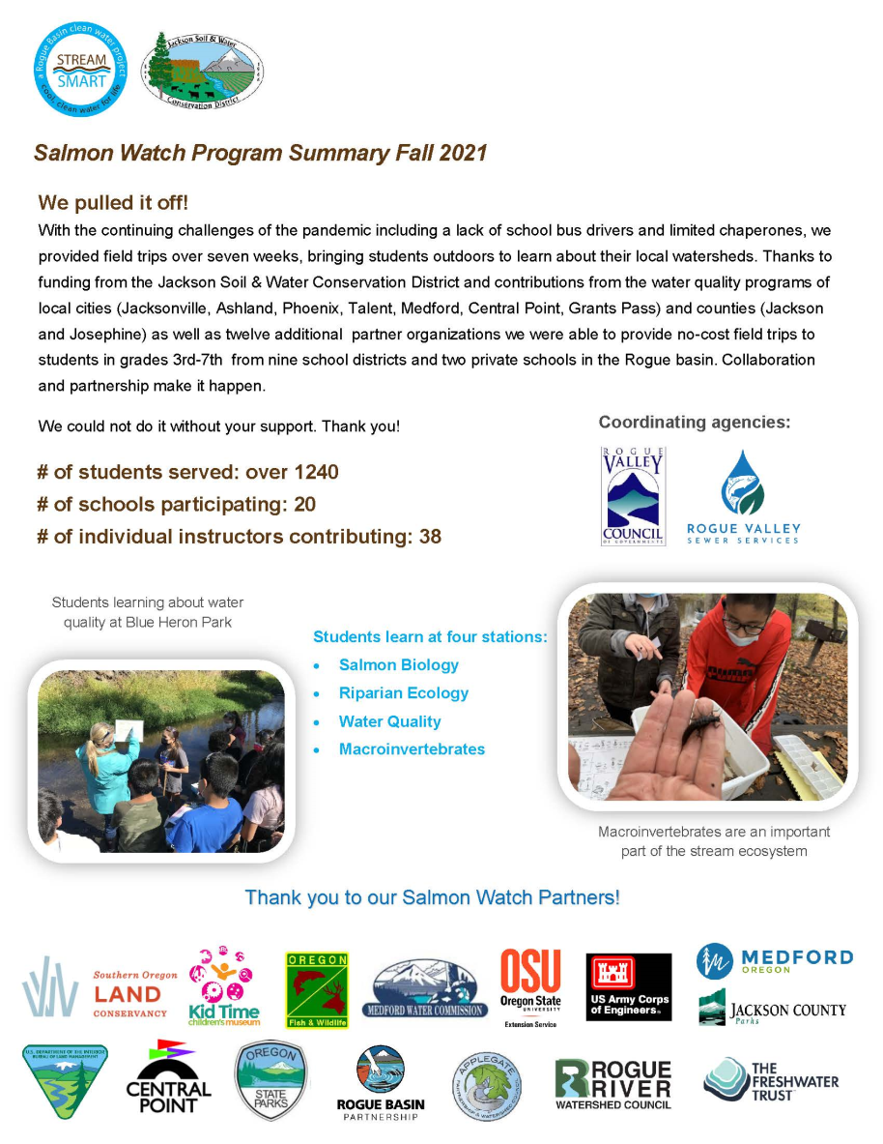
2021-2022 Stats
75 Students
2 Schools
Volunteer instructors
RVCOG
ODFW

Slide 47
https://www.youtube.com/watch?v=XQeVouErtks&list=UUM1cVIL9V8HH0TJhEq4zfHw

