Slide 2
Len Farr
Greg Stabach
Principal Geologist
Stantec
leonard.farr@stantec.com
Natural Resources Manager
Rogue Valley COG
gstabach@rvcog.org

Slide 3
Preventing Wildfire-Impacted Properties from Becoming Brownfields
Notes:
Impacts of wildfires on brownfields properties – pre and post fire

Slide 4
Notes:
Area map showing medford area in oregon?

Slide 6
Almeda Drive Wildfire Overview

Slide 7
Background
Fire began in the AM of September 8, 2020 near Ashland, Oregon
Strong winds caused the fire to move quickly to the northwest
The path of the fire followed OR-99 through Talent and Phoenix
Wildfire burned for approximately 36 hours
Mandatory evacuations in Ashland, Phoenix, Talent, and Medford
Total length of fire approximately 7 miles
Amazingly, only three people were killed by the wildfire

Slide 8
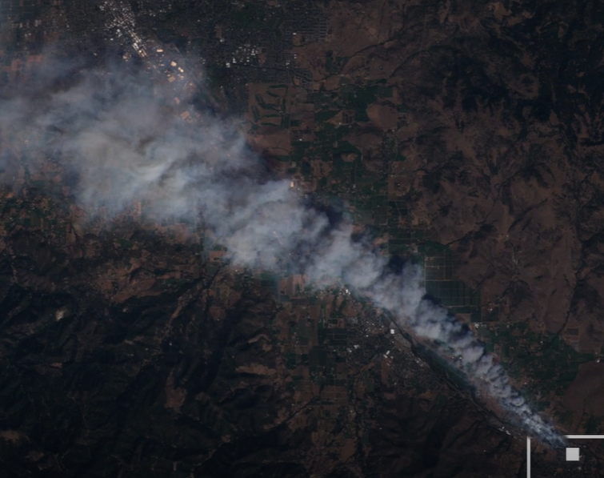
Background Continued

Slide 9
Background Continued

Slide 10
Background Continued

Slide 11
Background Continued

Slide 12
Background Continued
Notes:
70.1% of owner destroyed mobile homes were not insured.

Slide 13
Background Continued
2,537 homes including 18 mobile home parks were destroyed by the fire displacing 4,200 primarily low-income individuals.
171 commercial properties had structures that were damaged/destroyed causing substantial hardship to businesses, many of which have never re-opened.

Slide 14
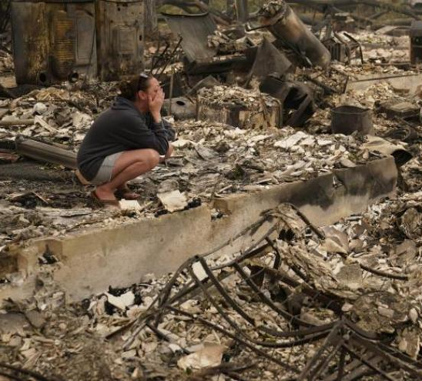
Background Continued
Most of the mobile homes destroyed were serving as unsubsidized affordable housing for low-income residents. More than 3,500 mobile home residents were displaced and included the Rogue Valley’s most vulnerable: low income, the elderly, and Latinx families including many seasonal agricultural and forestry workers.
Notes:
The median home price in Medford is $265,400. Due to the lack of affordable housing in Medford, low-income residents are forced to rent or buy 30-to-40-year-old mobile homes in poor condition in Phoenix/Talent.

Slide 15
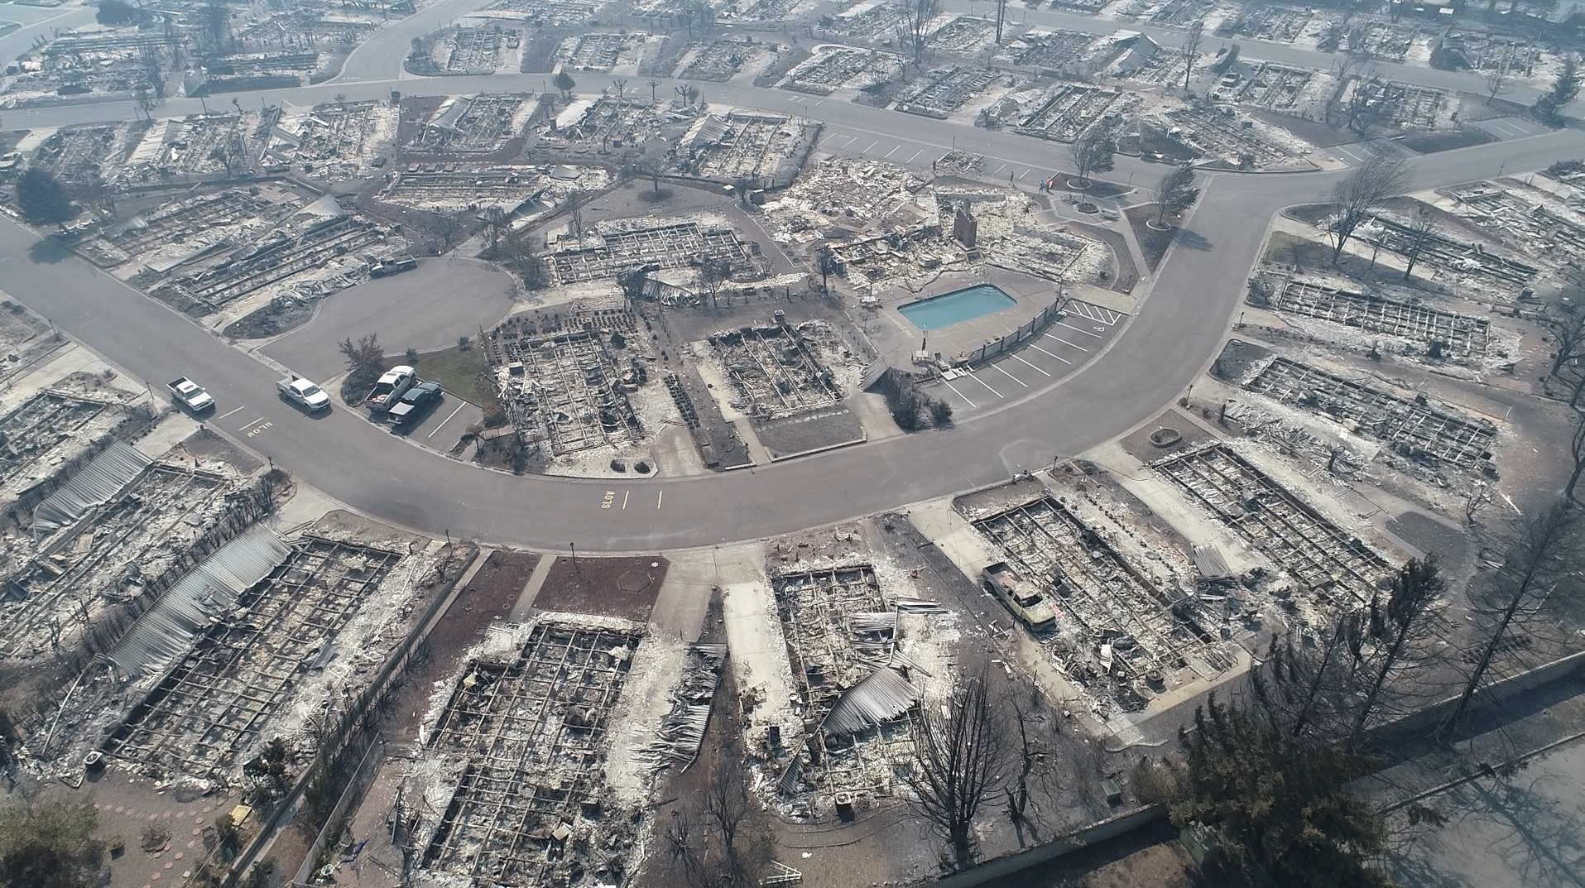
Background Continued
Portions of downtown Talent and Phoenix destroyed by the fire.
Impacted several miles of Highway 99
Notes:
The median home price in Medford is $265,400. Due to the lack of affordable housing in Medford, low-income residents are forced to rent or buy 30-to-40-year-old mobile homes in poor condition in Phoenix/Talent.

Slide 16
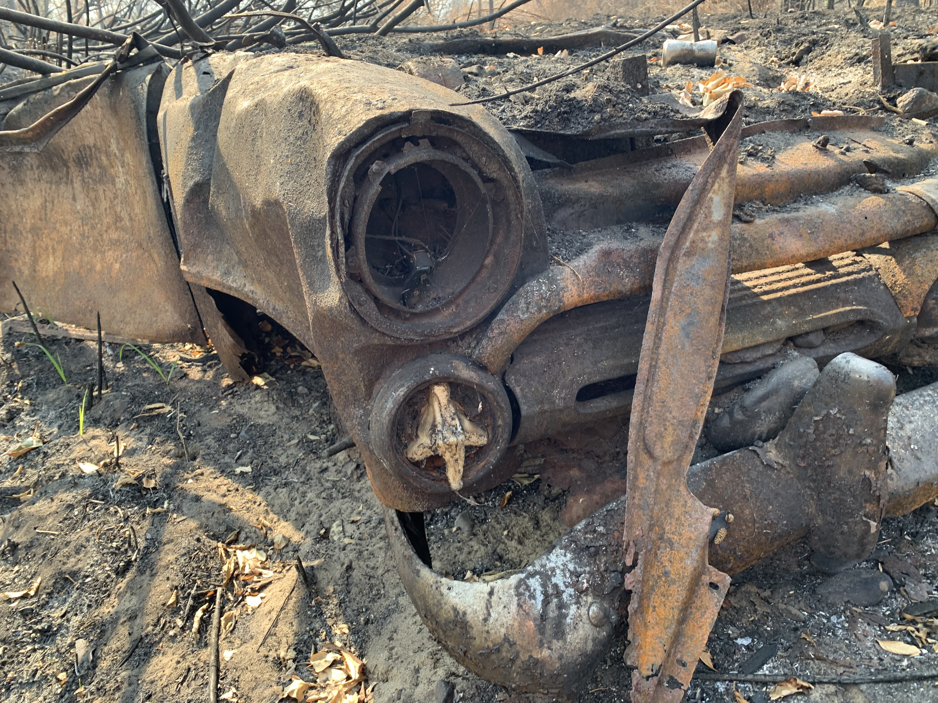
Brownfield Definition
A property, the expansion, redevelopment, or reuse of which may be complicated by the presence or potential presence of a hazardous substance, pollutant, or contaminant.

Slide 17
Brownfield Identification
Completed inventory of brownfields within wildfire footprint
Historical city directories
Historical aerial photographs
Historical maps
Environmental records
Windshield survey
Improved value to land value ratio (underutilized?)

Slide 18
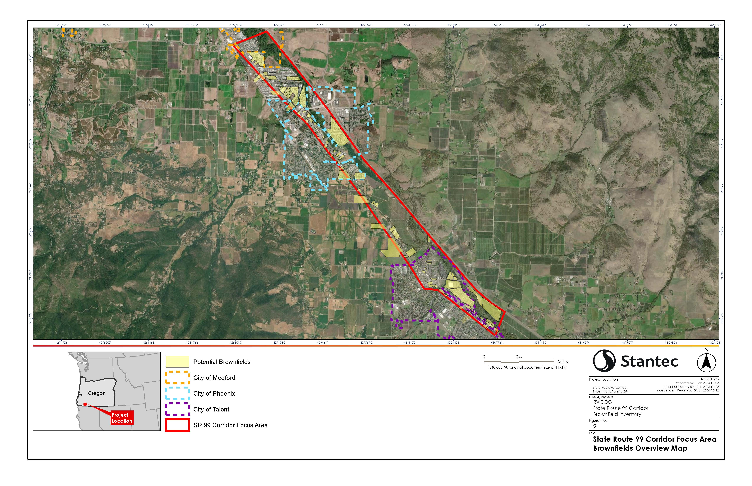

Slide 19
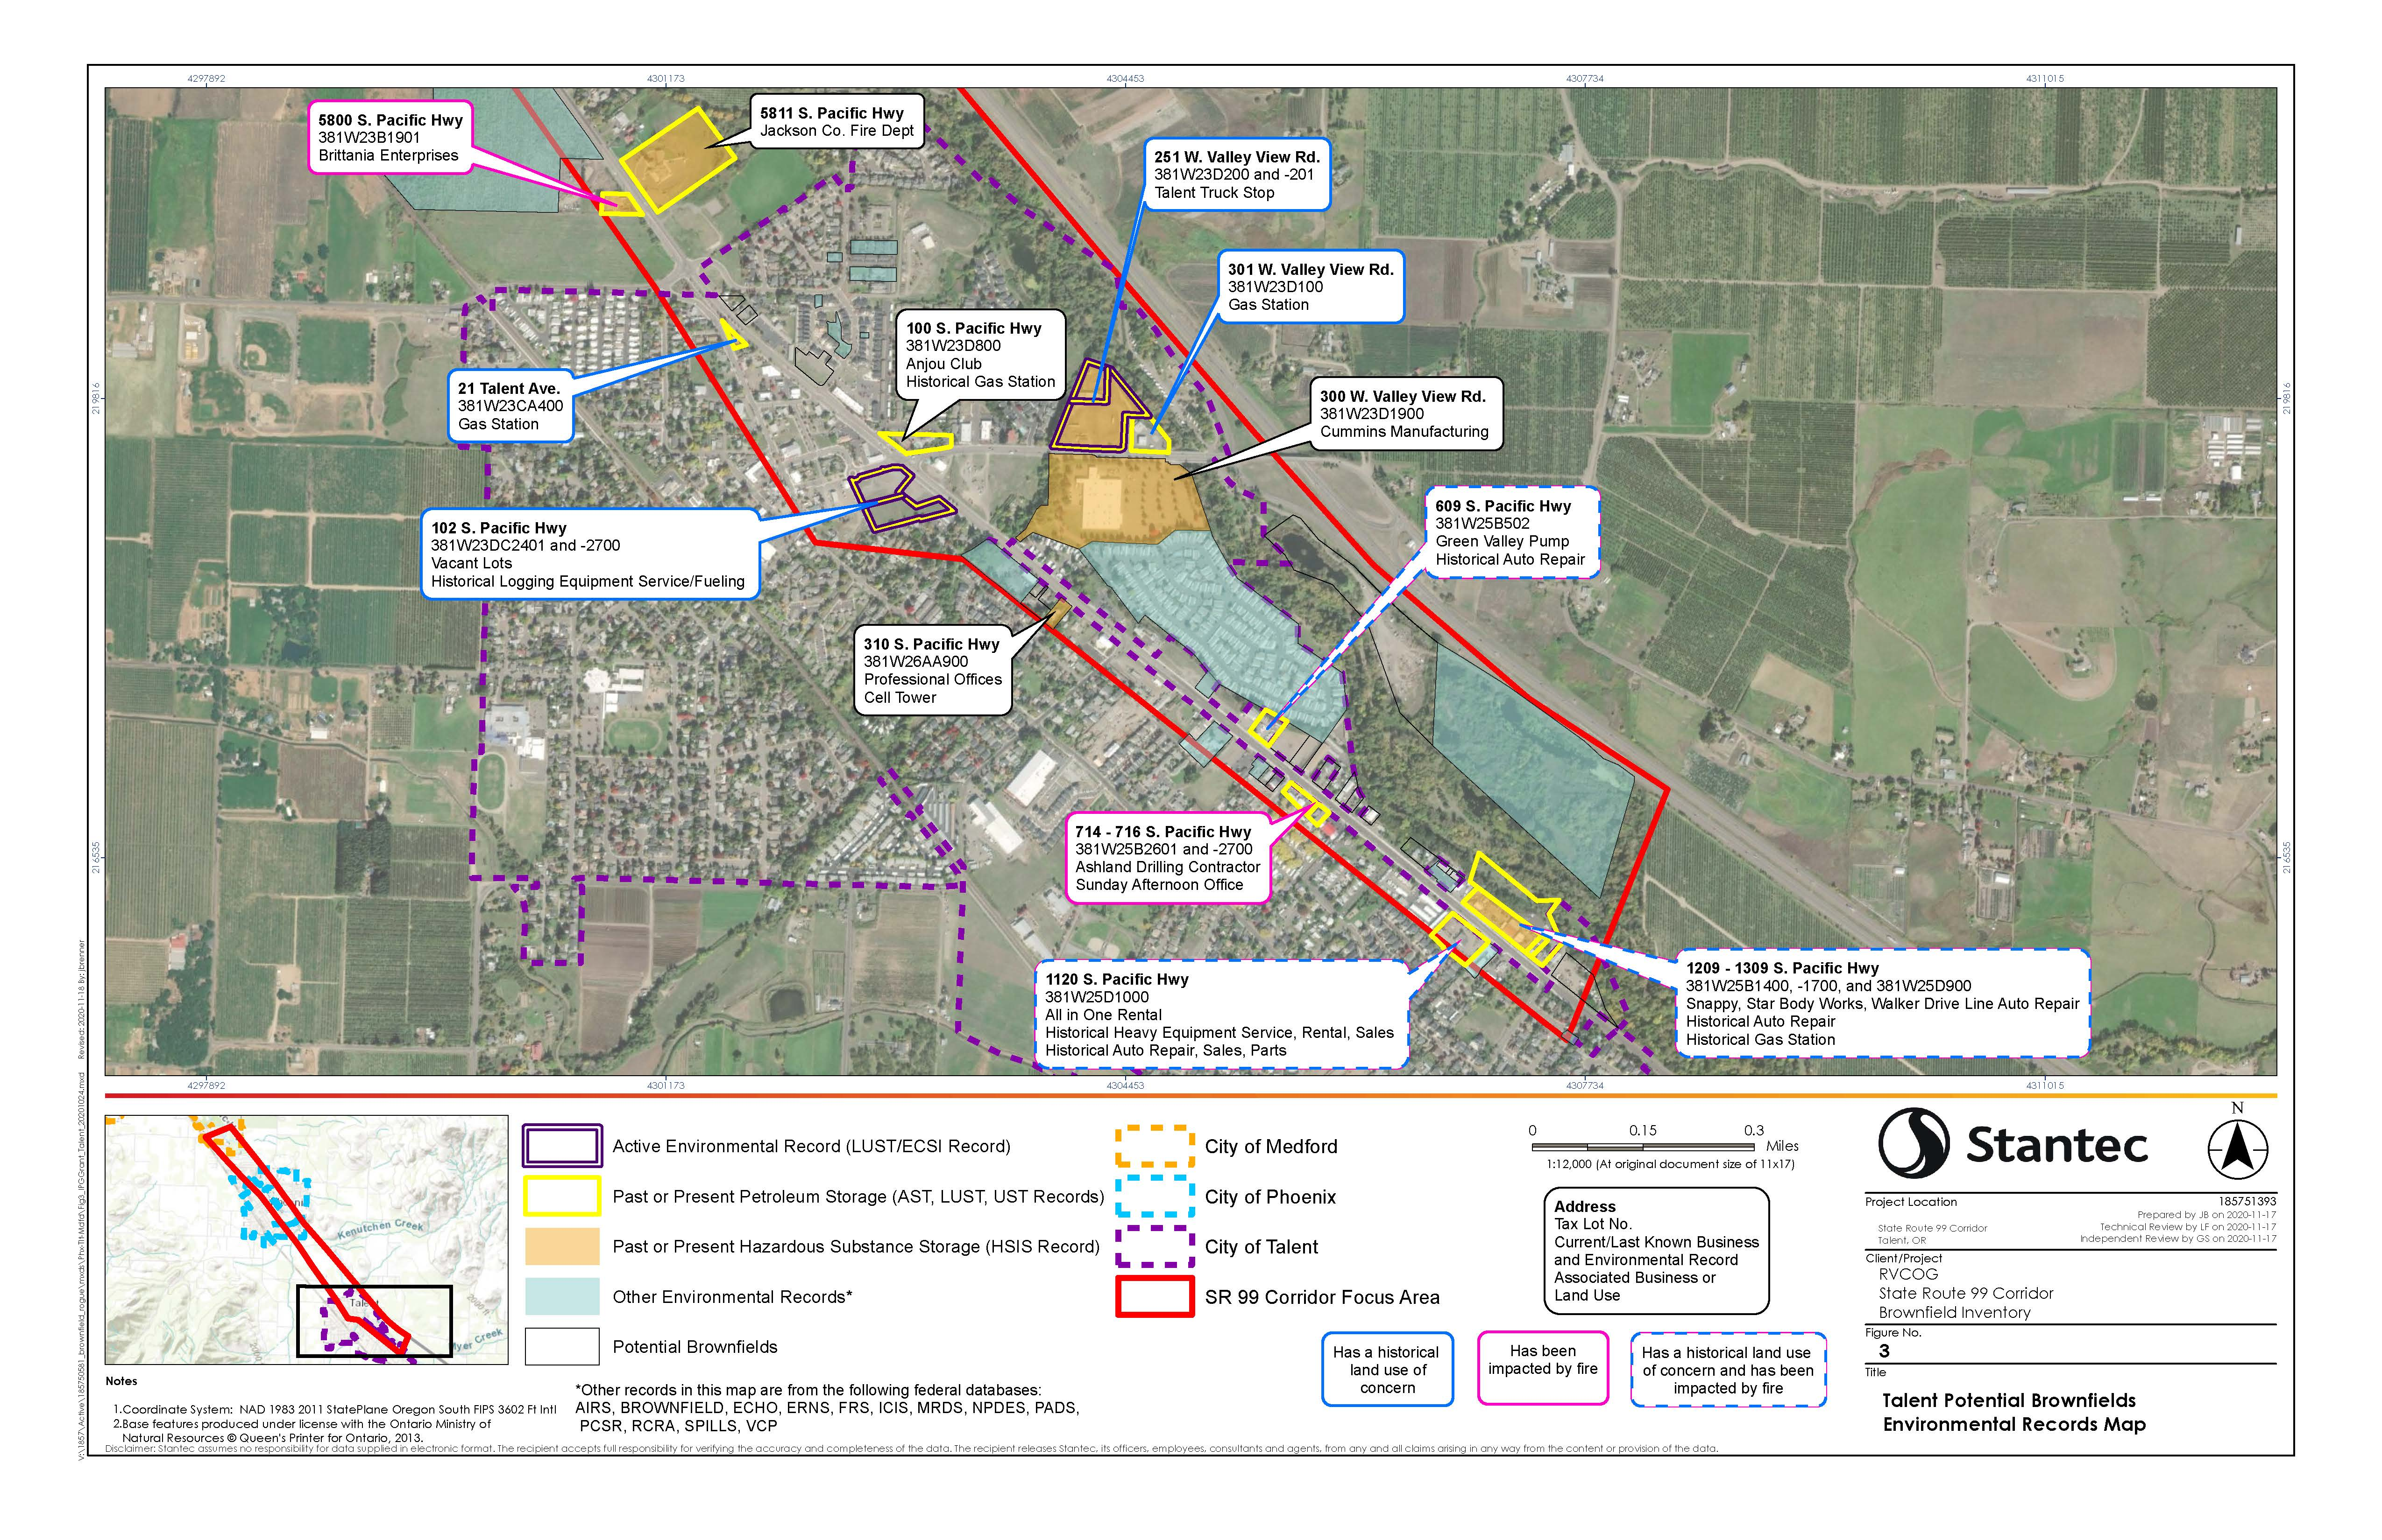

Slide 20
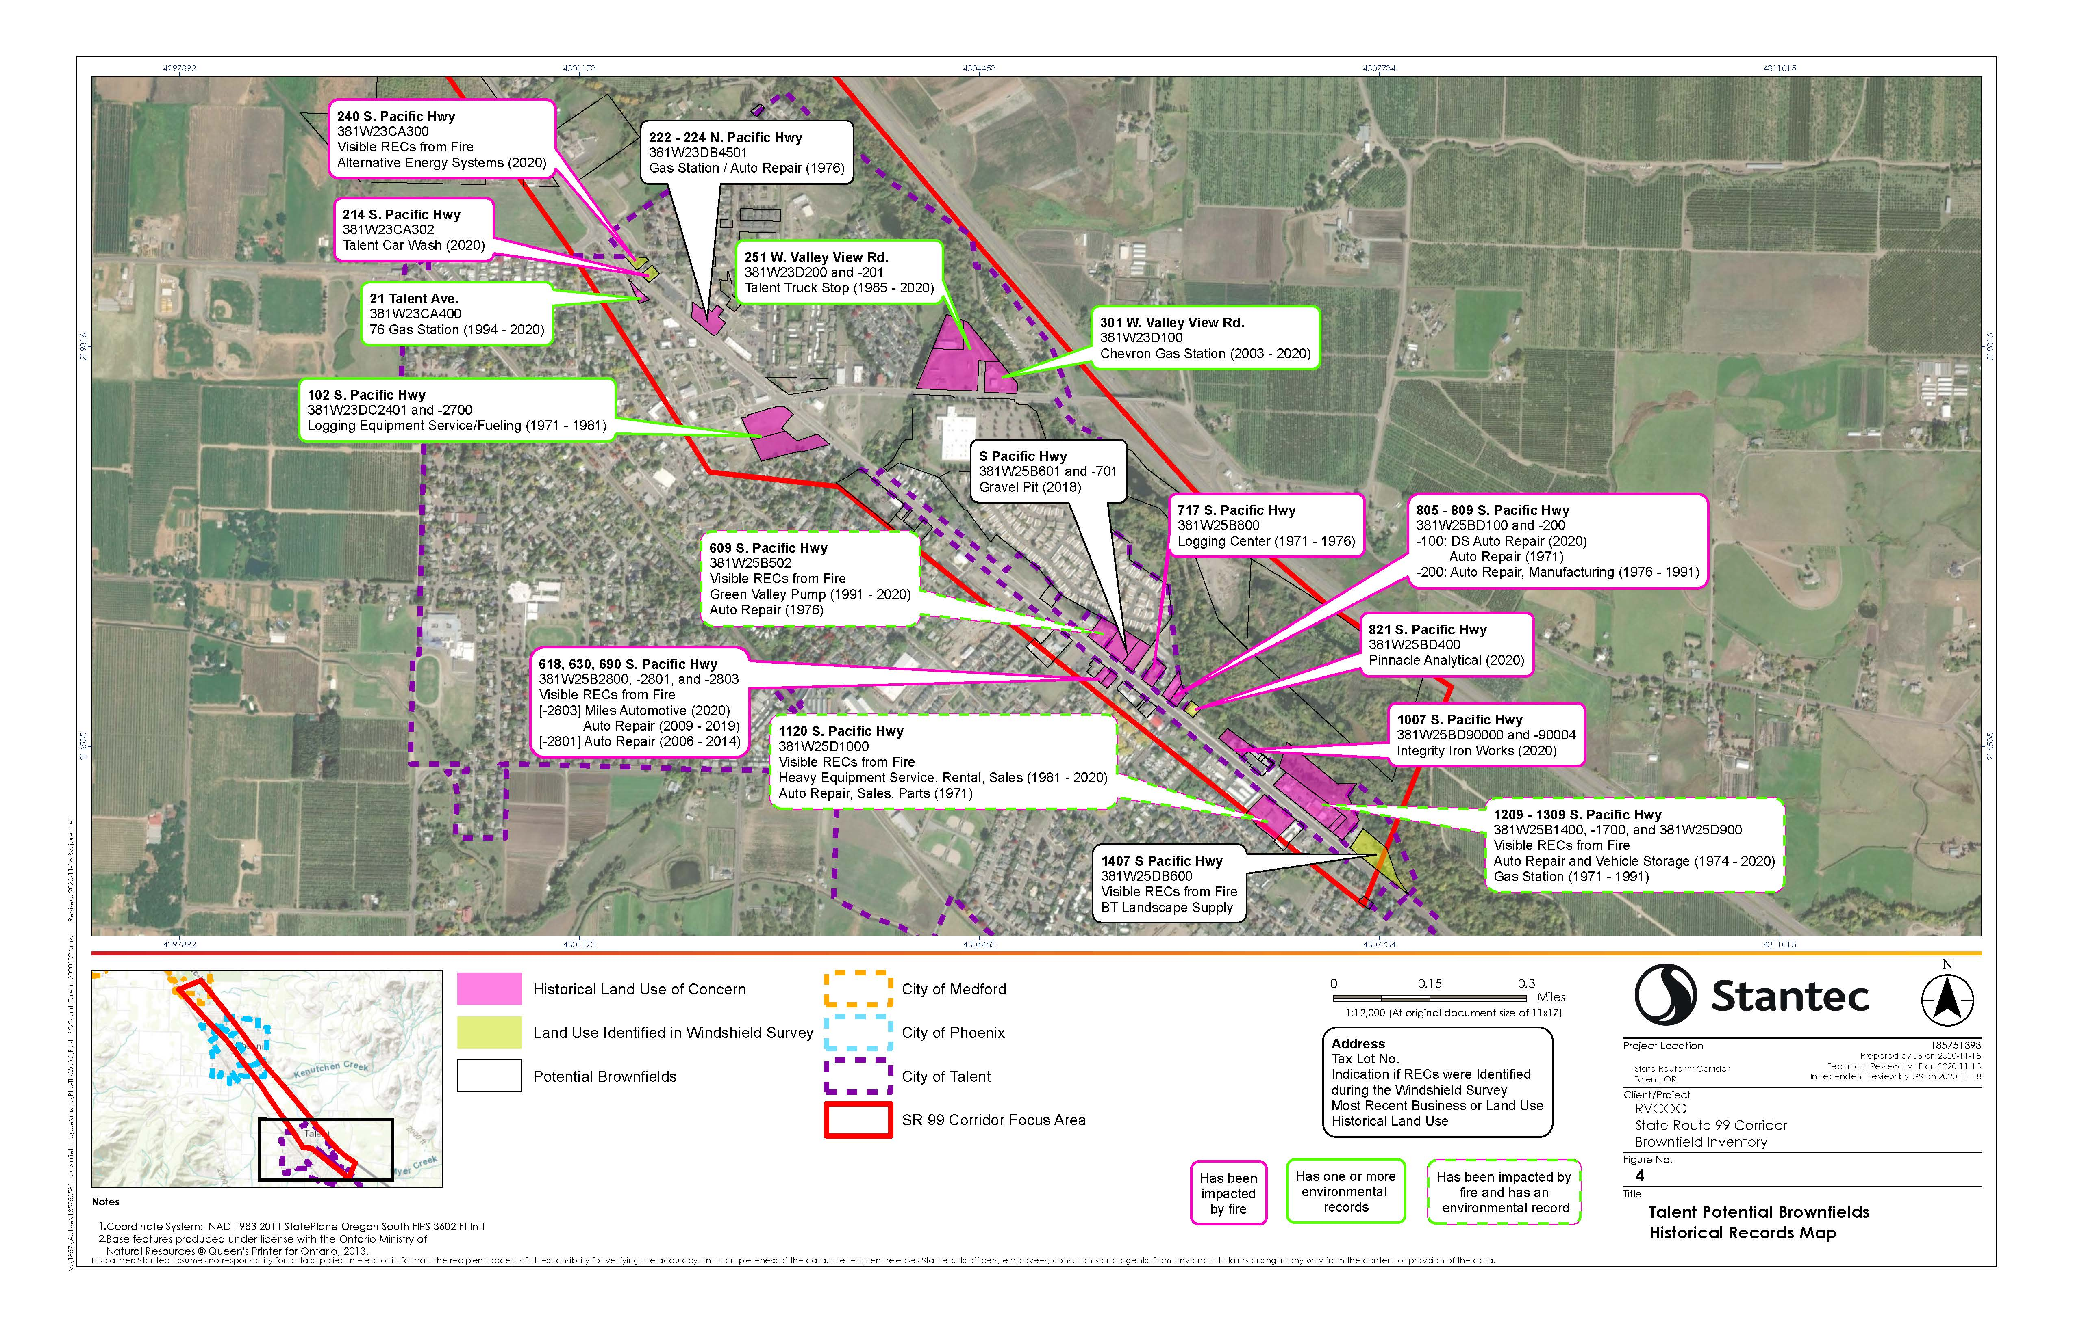

Slide 21
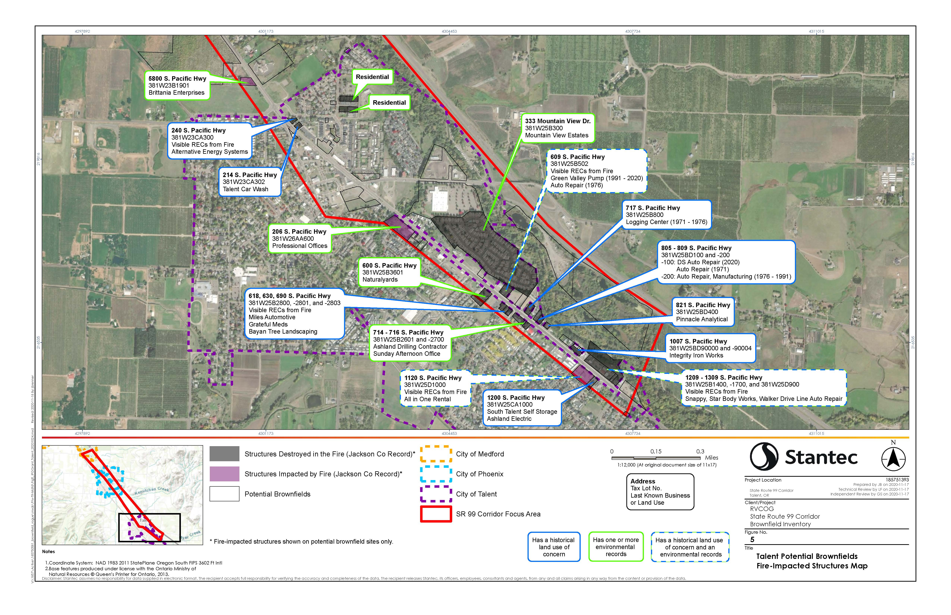

Slide 23
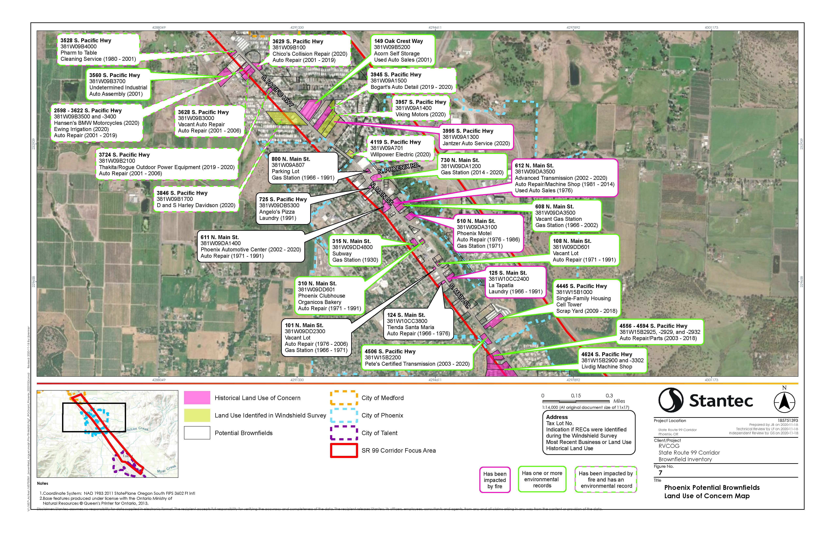

Slide 24
